Slide 1
EHA GRANTS
EHA NS Days 2025
14 February 2025 – Jess Morhayim

Slide 2
Agenda
EHA Grants Overview
Extending the Reach of EHA Grants
  EHA Research Grants
  EHA Innovation Grants
Researchfish

Slide 3
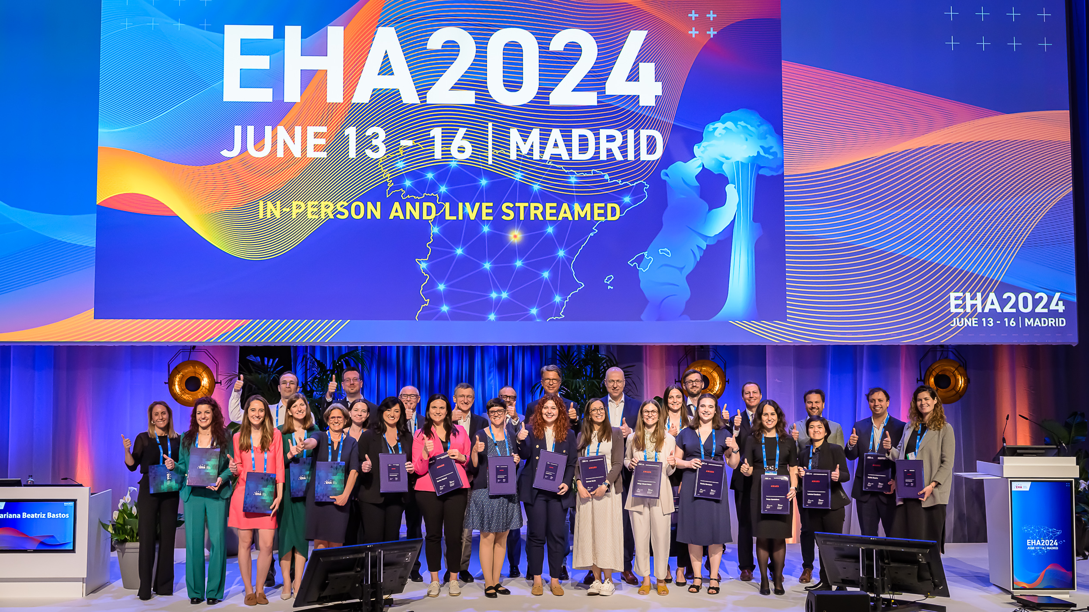
EHA Grants
EHA accelerates the career development of researchers and clinicians in hematology through research funding, unique collaboration, and powerful mentoring opportunities

Slide 4
EHA Grants
Since 2012
190 Grants
206 Grantees
€ 21,625,569

Slide 5

EHA Grants
  As of 2025, we have 5 different EHA Grant Categories
  Individual
  Collaborative
Research Grants
Bilateral Collaborative
Grants
Research Mobility Grants
Innovation
Grants
Kick-off Grants

Slide 6
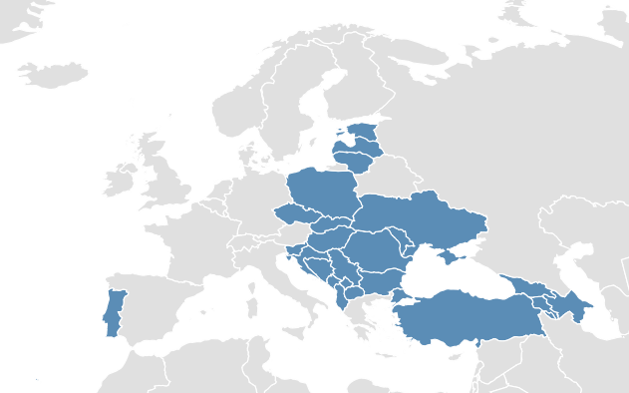
Extending the reach of EHA Grants
  In 2024, for the first time, EHA reserved grants for researchers operating in less-represented countries defined as:
      Received less than 5 grants in the last 10 years
      GDP/Capita is below European average

Slide 7
Extending the reach of EHA Grants
  For researchers operating in less-represented countries:
  2024 Grantees
  Czechia, Research Grants
  Croatia, Innovation Grants
  Croatia, Innovation Grants
  Portugal, Research Grants
  Portugal, Innovation Grants

Slide 8
EHA Research Grants
Basic or translational research
Support talented junior researchers in advancing their career
  Junior RG: Within 4 years from PhD/PharmD graduation € 150,000, 3 years
  Advanced RG: Between 4-8 years from PhD/PharmD graduation € 240,000, 3 years
  Physician Scientist RG: MDs who want to perform research € 240,000, 3 years
  Topic-in Focus RG: in “Hemoglobinopathies” or “Precision Hematology” (in any of the categories)
  2 Grants earmarked for researchers in less-represented countries
2025: We received 98 eligible applications, of which 15 were from less-represented countries
“I was notified about this Research Grant call by the Croatian Non-profit Cooperation of Hematological Disorders.”
- Quote from an applicant 2025

Slide 9
EHA Innovation Grants
Support the creation of consortia and the generation of preliminary data to facilitate applying for larger funding​
  High-quality clinical or translational research in hematology ​
  € 300,000 for 2 years
  At least 3 PIs from at least 3 different European countries, including at least 1 from a less-represented country
  Connection with one or more EHA Specialized Working Groups​
  At least one of the PIs must be within 5 years of his/her first senior appointment​​
Winners will be announced in April

Slide 10
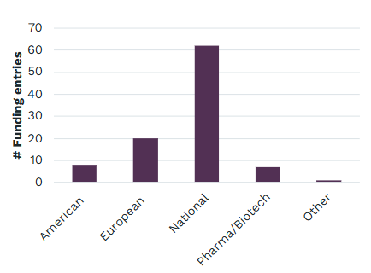
Researchfish: Impact Analysis
Annual survey to measure the impact of our programs on career development and trajectory
Further Funding (reported by 39 grantees)
€ 75,909,129 further funding was secured thanks to an EHA grant
Most further funding was acquired 1 to 5 years after starting the grant period​
Most of the funding was acquired from national (in Europe) non-profit organizations ​

Slide 11
Researchfish: Impact Analysis
Annual survey to measure the impact of our programs on career development and trajectory
Further Funding (reported by 39 grantees)
€ 75,909,129 further funding was secured thanks to an EHA grant
Most further funding was acquired 1 to 5 years after starting the grant period​
Most of the funding was acquired from national (in Europe) non-profit organizations ​
Publications (reported by 61 grantees)
425 articles were published across 145 different journal thanks to an EHA grant
Most publications were acquired within 3 years of starting the grant period​​

Slide 12
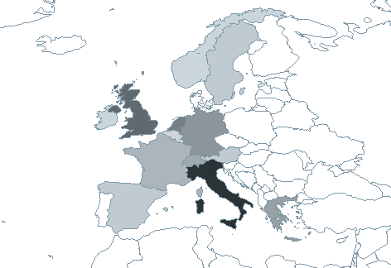
Researchfish: Impact Analysis
Annual survey to measure the impact of our programs on career development and trajectory
Further Funding (reported by 39 grantees)
€ 75,909,129 further funding was secured thanks to an EHA grant
Most further funding was acquired 1 to 5 years after starting the grant period​
Most of the funding was acquired from national (in Europe) non-profit organizations ​
Publications (reported by 61 grantees)
425 articles were published across 145 different journal thanks to an EHA grant
Most publications were acquired within 3 years of starting the grant period​​
Collaborations (reported by 34 grantees)
89 new collaborations were established thanks to an EHA grant
Most collaborations were with (52%) academic centers and
(29%) hospitals​ in Europe

Slide 13
Future Calls
Next Call: Research Grants 2026
Call opens: June 2025
Call closes: October 2025
Winners announced: May 2026
Next Call: Innovation Grants 2026
Call opens: October 2025
Call closes: January 2026
Winners announced: April 2026

Slide 14
Future Calls
Next Call: Research Grants 2026
Next Call: Bilateral Collaborative Grants 2026
Call opens: June 2025
Call closes: October 2025
Winners announced: May 2026
Call opens: June 2025
Call closes: October 2025
Winners announced: April 2026
Next Call: Innovation Grants 2026
Next Call: Kick-Off Grants 2025
Call opens: October 2025
Call closes: January 2026
Winners announced: April 2026
Call opens: June 2025
Call closes: September 2025
Winners announced: December 2025
Research Mobility Grants 2025: The call is open all year

Slide 15

Apply for the EHA Mentorship Program
The EHA Mentorship program is a new, career-focused program that provides individual mentoring support for early and mid-career clinicians and researchers in hematology.
This is a free, twelve-month program in which up to 50 mentor-mentee pairs, based in Europe, meet at least four times (online). There is one physical meeting at the EHA Congress, facilitated and supported by EHA.
Take the opportunity to develop your full potential on a career-development level
Accelerate your career progress and innovation in research and clinical practice
Grow your communication and collaboration skills in an international setting
Deadline for mentee application is
February 20, 15:00 CET
European
Hematology
Association
eha.fyi/EHAMP-2025

