Slide 1
Dr Sue Pavord
President

Slide 2
Established in 1960
Registered charity,
With an associated company BSHE
Aims to transform patient care through excellence in haematology
Education
Networking
Advocacy

Slide 3
Strategy 2024-2026
Membership
Knowledge sharing
Strategic partnerships
BSH infrastructure

Slide 4
Membership
3450 members
Open to anyone engaged in the practice or study of haematology,
undergraduates
consultants and junior doctors,
clinical and biomedical scientists,
specialist nurses
Physicians associates
other allied health professionals.
Notes:
>3000
Applications are reviewed every month in the NGAC Governance meeting
The most comprehensive list of benefits to being a BSH member can be found on the membership page of the website

Slide 5
Education
ASM - around 2000 delegates
other educational events – 18 in 2024, with 1550 delegates
BSH guidelines – 2024 - 12 guidelines and 5 GPP
British Journal of Haematology, (IF 8)
Electronic Journal of Haematology (eJH)

Slide 6
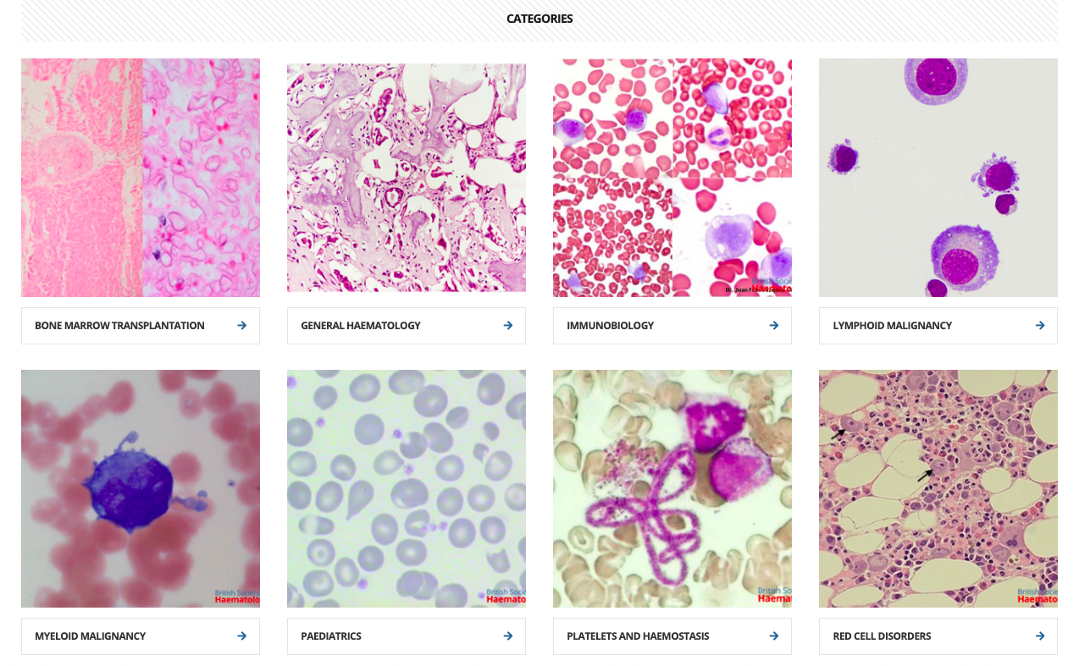
Educational content on website
Lectures
Demonstration videos
Practice questions – essays, MCQs, EMQs, case reports
Image bank
News items
Guidelines
Information about conferences
and events

Slide 7
Grants Registries
Name of database
Audit Tool - QS138 Quality Insights (Blood Transfusion)
Bedside Transfusion Audit
Blood Donation
Blood Sodium Study
Cord Blood Bank
Follicular lymphoma first line PETReA plus, ongoing registry
follicular lymphoma refractory
Idiopathic Thrombocytopenia Purpura registry
Mantle cell lymphoma
Myeloma
Myeloma
National aHUS Register
National Haemoglobinopathy Registry
National Haemophilia Database
National Immunoglobulin Database
Platelet Donation
POEMS syndrome
Serious Hazards of Transfusion
UK Paediatric Idiopathic Thrombocytopenia Purpura Registry
UK Primary Immunology Deficiency Registry
UK Thrombotic Thrombocytopenia Purpura Registry
Waldenstrom's Macroglobulinemia Registry
Non-Hodgkin Lymphoma
Notes:
ASM – top abstracts – awarded automatically, £1000 towards registration and expenses to attend the conference
ASH-BSH up to 3 top abstracts receive $2000 and complimentary registration to ASH
To study cohorts of rare disease
Early stage- beginning independent research
Global haematology – travel abroad to learn new techiniqes, set up research, strengthen international links
Meeting support – to attend other BSH meetings
Student elective scholarships for undergrads, nurses, physicians assistants
Vising fellow – 18,000 for one year

Slide 8
Special interest groups
New for 2025:
Supportive care SIG

Slide 9
Committees
Guideline writing groups
Sounding boards
Notes:
Gain transferable skills sitting on committees and being able to shape and influce the support the BSH gives to its members

Slide 10
Advocacy work
Working collaboratively on projects with other organisations
25 BSH representatives on other organisations
Input into consultations and surveys
Workforce project
Notes:
Contributing to the advocacy work
To ensure haematologyin being heard within the wider conversations being had around medicine.
The larger and more involved our membership the bigger our voice we will have in these areas

Slide 11
Workforce project
1. Workforce gap analysis
2. Practitioner wellbeing
3. Identification of solutions and improvements

Slide 12
Workforce project
Commissioned London South Bank University
Qualitative and quantitative research
5 research papers submitted
Identified areas of unseen work:
Liaison haematology and transfusion medicine
Delphi study to Define liaison haematology
Identified emotional burden of haematologyworkforce
Aiming to influence policy, change job plans
Notes:
joining us as our research partner for a large scale workforce project.

Slide 13
Strategy Pillar 4
Infrastructure
Income diversification
Operational plan
IT systems
Sustainability

