Slide 1
Building a support system for hematologists with challenging cases
13 February 2025

Slide 2
What has been done
Review of the system that is used in Czechia with the Working Group
Review of the different available tools within EHA
First set up of the tool

Slide 3
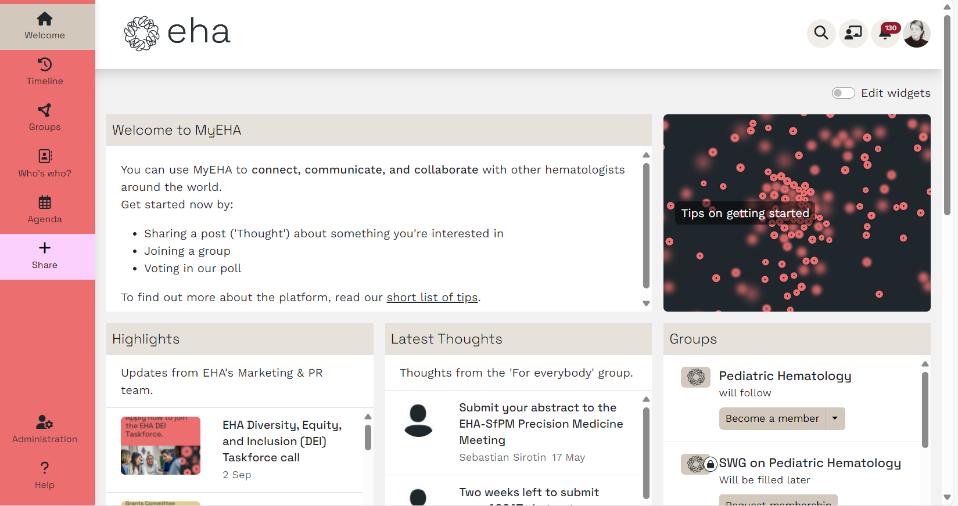

Slide 4
Next steps for a support system for hematologists with challenging cases.
Meet-up with the working group (March 2025
Platform training organized by EHA Executive Office (March/April 2025)
Testing within the working group (May 2025)
Inviting topic specialist to serve as the response panel (April 2025)
Launch a public Group on the Platform (June 2025)

