Slide 1
Estonian Society of Hematology
EESTI HEMATOLOOGIDE SELTS
Mari Punab
EHA NS Days 2025

Slide 2
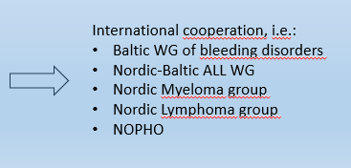
Estonian Society of Hematology (EHS)
Non-profit organization of hematologists and doctors of adjacent specialities
54 members: hematologistists (30+8), hematopathologists, laboratory specialists, geneticists, radiologists
Founded in 13/09/2003
6 working groups:
Bleeding disordes
Chronic myeloproliferative diseases
Acute leukaemias
Malignant plasma cell disorders
Malignant lymphomas
Pediatric hematology-oncology

Slide 3
EHS
Activities to promote the care for haematological patients
Negotiations with State Health Insurance Fund and State Health Agency
Applications for new health care services to become reimbursed
Assessment of need of new medical services applied
Participations in development of treatment guidelines
Advanced education
Twice a year ESH seminars
Hematology School
Baltic Hematology Conference – since 1998

Slide 4
EHS
Raising awareness of the patients and community
Educational materials for patients
Lectures – virtual and on-site
Leukeemia.ee, kasvaja.net
Public campaignes
Myeloma days
Stem cell donorship
Bleeding disordes 2017…2024 on hemophilia day

Slide 5
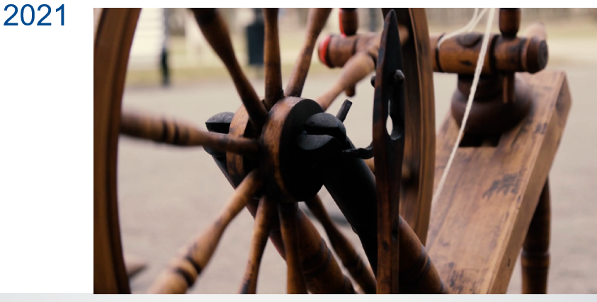
EHS
Raising awareness of the patients and community
Educational materials for patients
Lectures – virtual and on-site
Public campaignes
Bleeding disordes 2017…2024 on hemophilia day

