Slide 1
HUNGARY
Csaba Bödör

Slide 2
1st joint EHA-HSHT joint session at the XXIV. Lymphoma Congress of HSHT in Budapest (June 6, 2024)
E

Slide 3
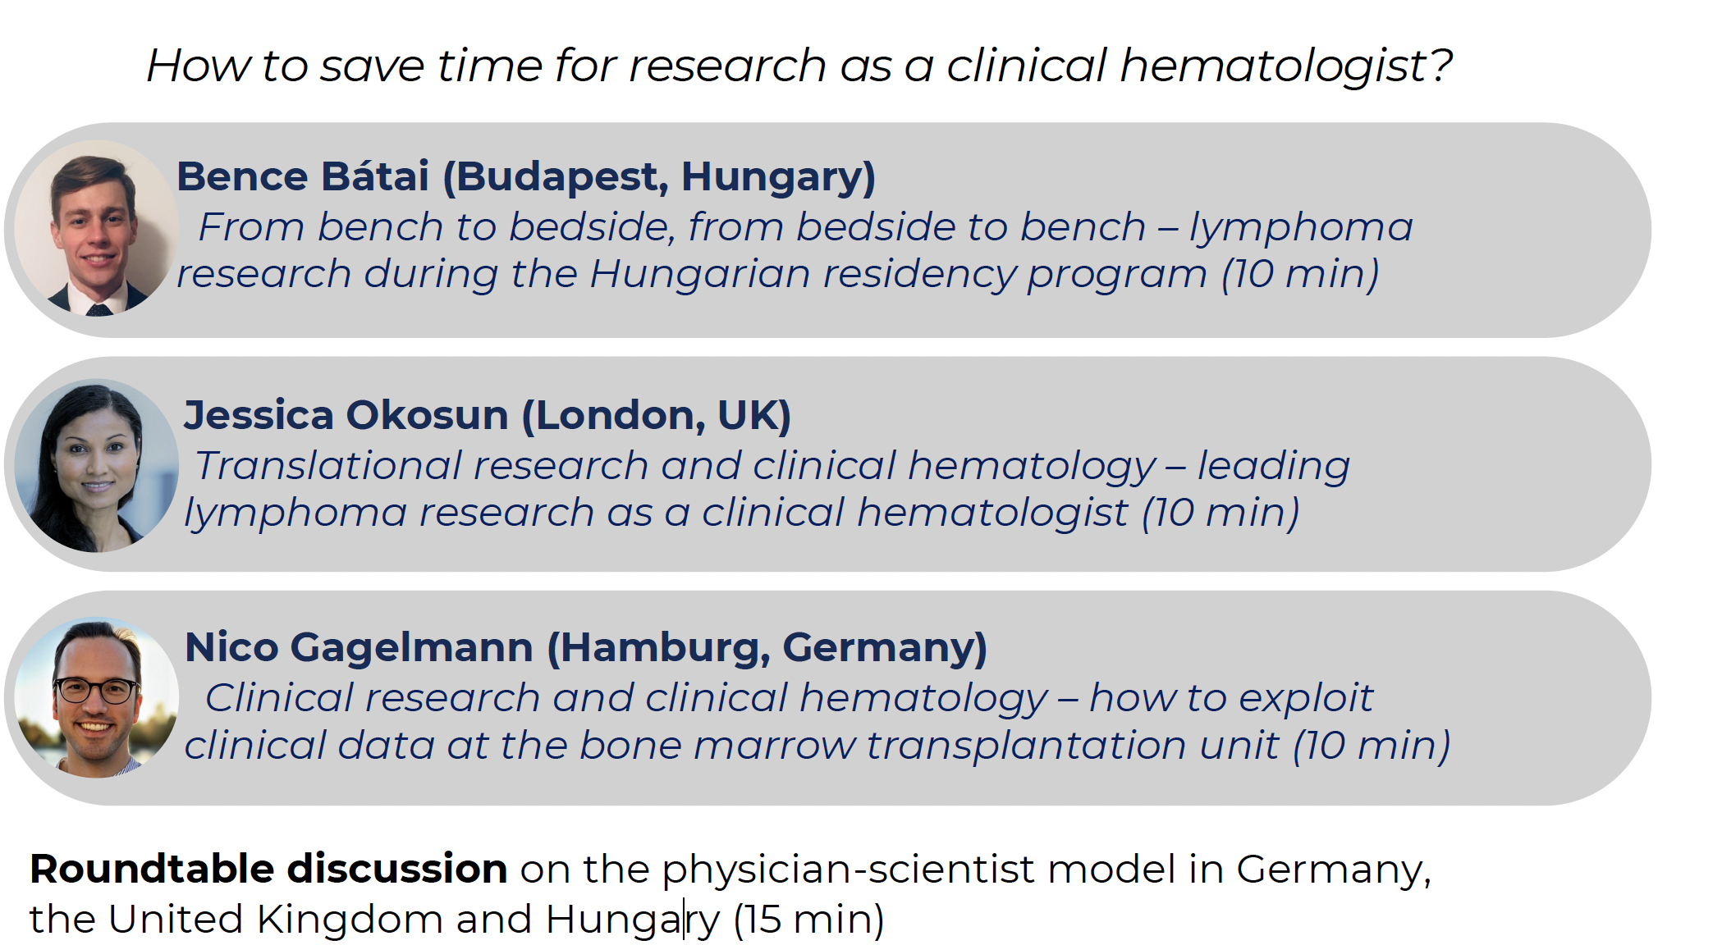
1st joint EHA-HSHT joint session at the XXIV. Lymphoma Congress of HSHT in Budapest (June 6, 2024)

Slide 4
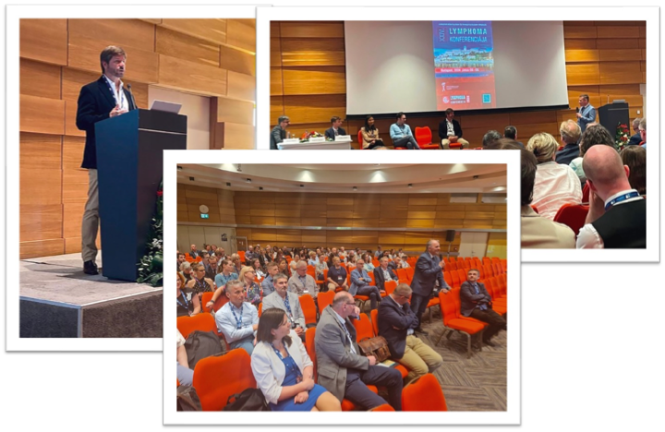
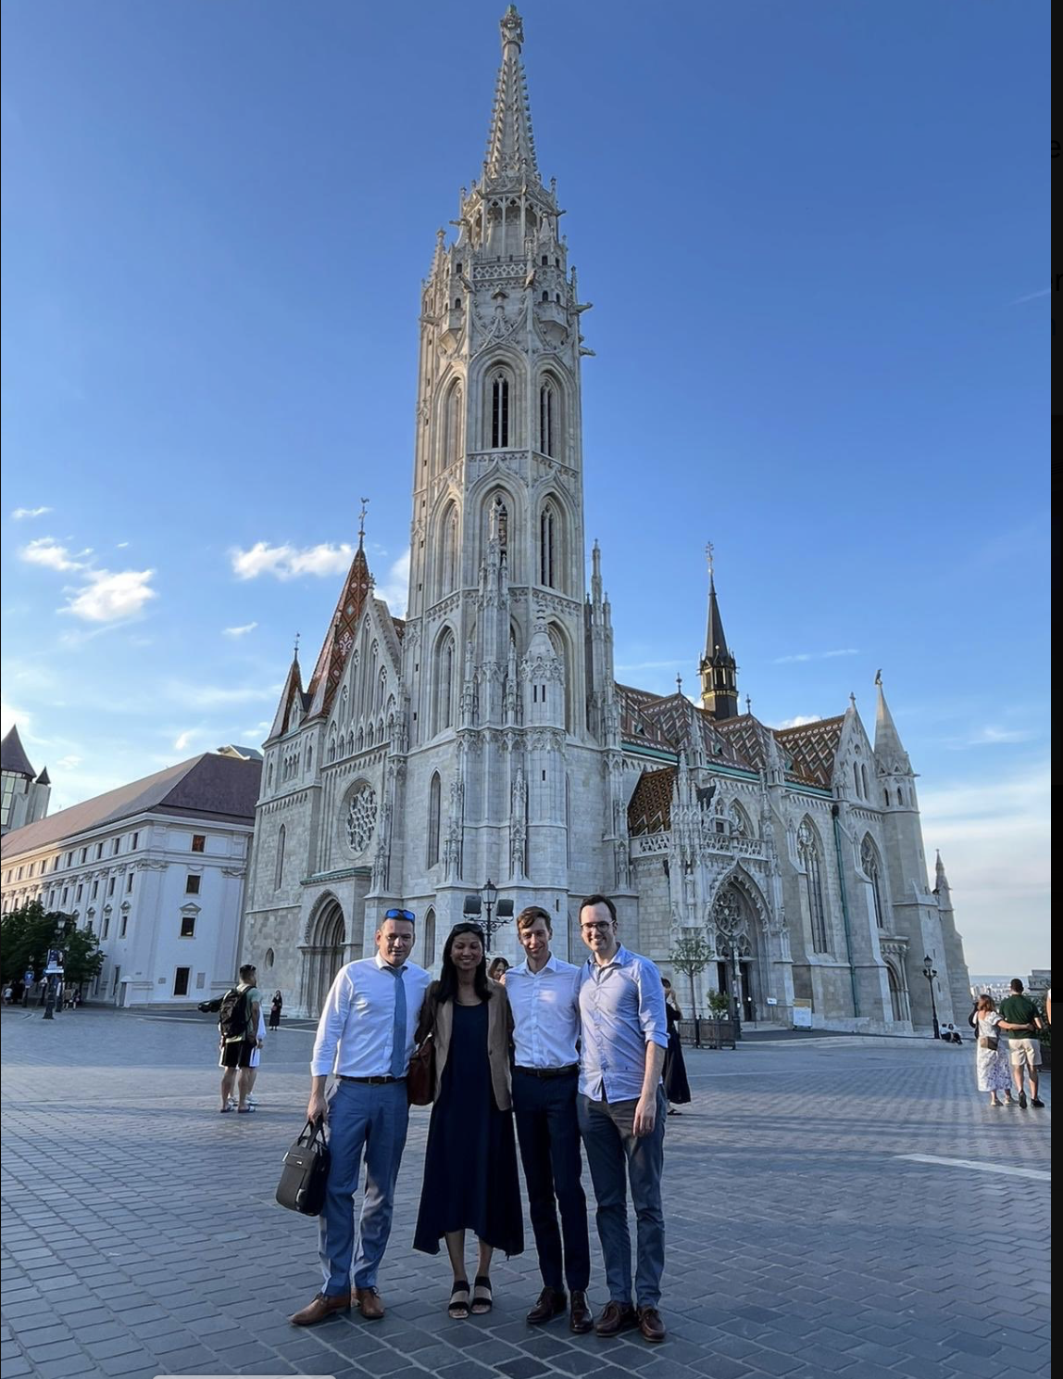
1st joint EHA-HSHT joint session at the XXIV. Lymphoma Congress of HSHT in Budapest (June 6, 2024)

Slide 5
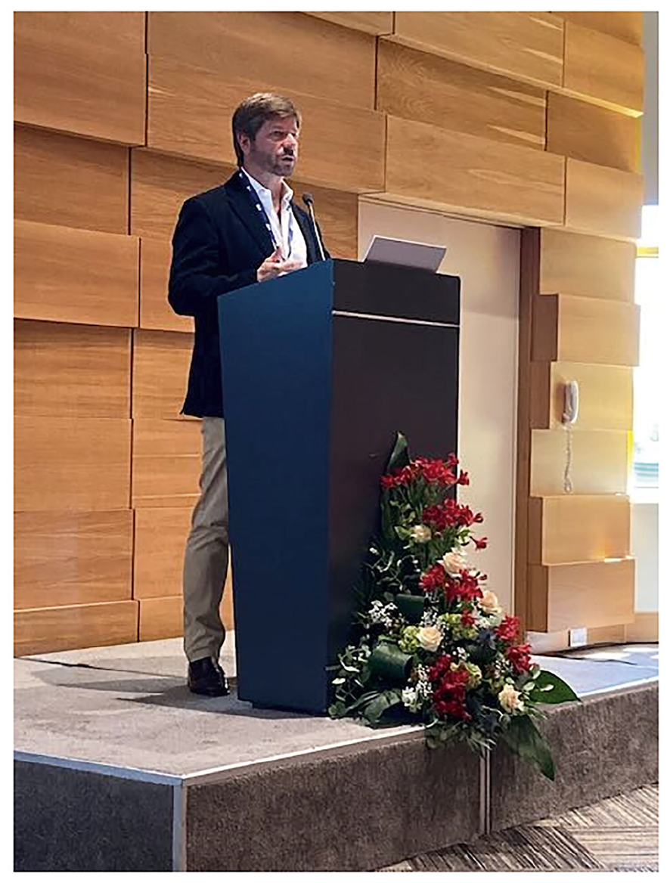
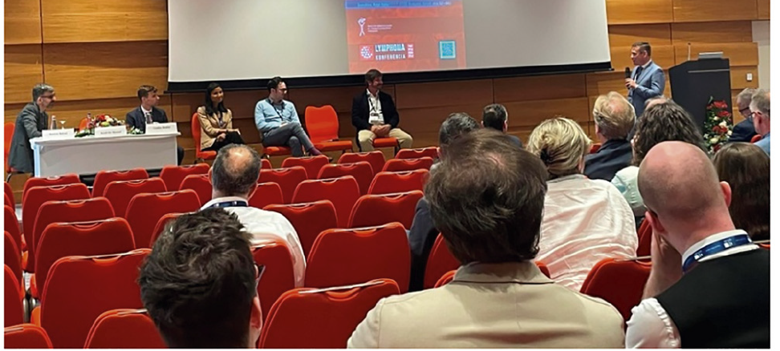
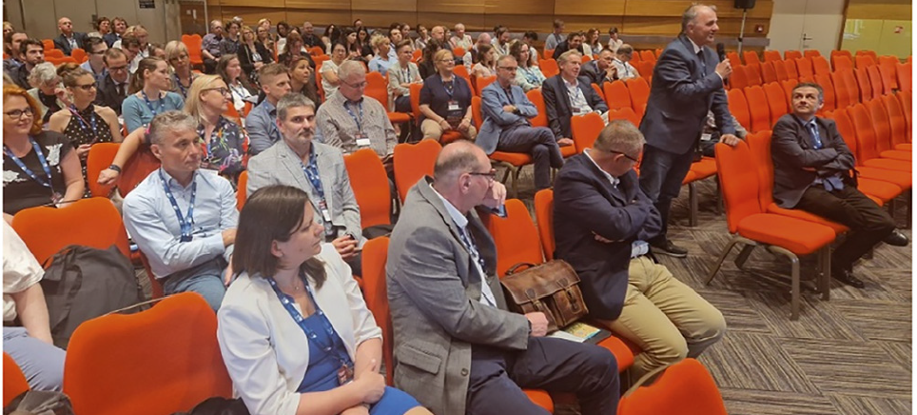

Slide 6
To be continued ...
2nd joint EHA-HSHT joint session at the 2025 National Congress HSHT in Szeged (May 22-23, 2024)
Spotlight on national and international working groups

