Slide 1
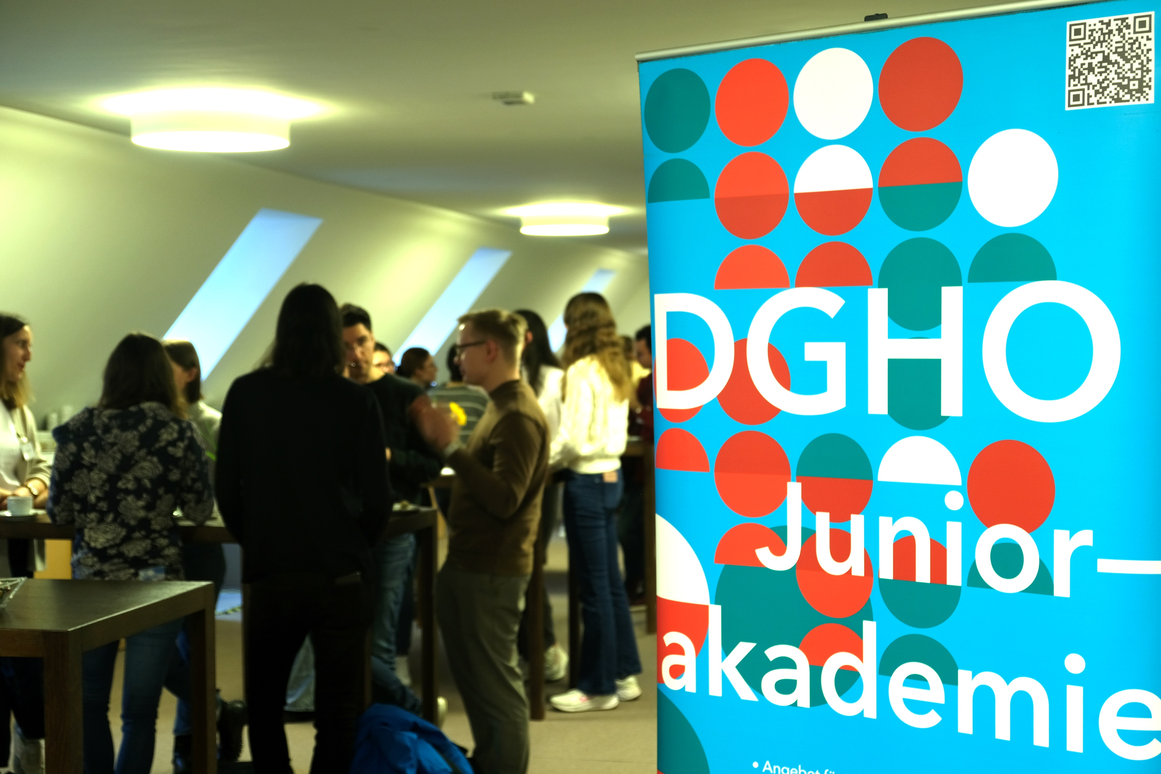

Slide 2
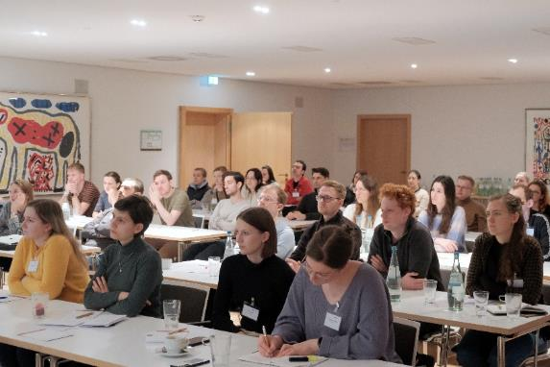
Annually since 2012
February of each year
‘isolated’ location
3 days
30 – 35 young physicians or advanced students
10 – 15 presenters
Presentations, workshops & outdoor activity
50% stay in the field

Slide 3
Juniorakademie 2025
Mittwoch, 12. bis Freitag, 14. Februar 2025
Neudietendorf (Thüringen)

