Slide 1
European Hematology Association Strategic Storyline
Antonio Almeida
EHA President
February 2025

Slide 2
Direction & Focus
Prioritization
Alignment & Coordination
Risk Management
Measure Performance
Engagement & Communication
Data Driven Decision Making
Why a Strategic Roadmap is Important
Notes:
Limited access to care:
many regions, particularly in low- and middle-income countries, have limited access to hematology services, including diagnostics, treatment, and specialized care for conditions like leukemia, lymphoma, and sickle cell disease. Access to advanced hematology treatments can be limited by factors like geographical location, socioeconomic status, and healthcare infrastructure. Some therapies, such as CAR-T cell therapy, are costly and not widely available in certain regions.
Shortage of specialists:
there is a global shortage of trained hematologists and specialized healthcare workers, leading to delays in diagnosis and treatment, particularly in rural or underserved areas. Advancements in hematology require a highly skilled workforce, from clinical researchers to hematologists with expertise in cutting-edge therapies. There is a shortage of specialists with the necessary training, particularly in emerging areas like immunotherapy and genetic engineering.
Increasing cost of treatment
hematologic treatments, such as bone marrow transplants, gene therapies, and targeted therapies, are often prohibitively expensive and not covered by insurance in many countries, limiting access for patients. The high costs involved in research, production, and distribution make it difficult to bring innovative treatments to a broader patient population quickly
Diagnostic challenges:
accurate diagnosis of blood disorders can be challenging due to a lack of advanced diagnostic tools, particularly in low-resource settings. this leads to misdiagnosis or delayed diagnosis. Especially with individualized treatments based on genetic profiles and molecular diagnostics. Integrating precision medicine and diagnosis into standard care is complex, requiring robust infrastructure, interdisciplinary collaboration, and ongoing education for healthcare professionals.
Data Integration and Sharing
Hematology, like many other fields, is data-intensive. Integrating genomic data, patient records, clinical trial data, and real-world evidence is difficult due to fragmentation across institutions and lack of standardized systems. Sharing this data securely and effectively is critical to accelerating research and developing new therapies.
Inequities in research and innovation:
most hematology research and clinical trials are concentrated in high-income countries, leading to a lack of relevant data and innovations tailored to the needs of low- and middle-income countries. To accelerate advancements, clinical trials must include diverse populations to ensure that treatments are effective across different demographics. However, there are significant challenges in recruiting diverse patient groups, especially in underrepresented communities
Disease burden:
certain hematologic diseases, like sickle cell disease and thalassemia, have a high prevalence in certain regions but receive relatively little attention and funding compared to other global health issues. Balancing access to the latest treatments with cost-effectiveness is a constant challenge for payers and providers.
Public awareness and education:
low awareness of hematologic conditions among the general population and even among healthcare providers can result in late presentations, suboptimal treatment, and preventable complications. This lack of awareness can delay early diagnosis and limit support for cutting-edge treatments. The scientific complexity of hematological conditions and the rapid pace of advancements make it difficult to effectively communicate important information, leading to misconceptions and missed opportunities for timely interventions and research advocacy.
Regulatory and policy hurdles:
regulatory barriers, including approval processes for new therapies and drugs, can delay access to innovative treatments in many countries. As hematology shifts toward more innovative treatments such as gene editing and stem cell therapies, regulatory frameworks need to evolve to balance patient safety with innovation. Ethical concerns related to emerging therapies, especially gene therapies, can delay approval and adoption.
Interdisciplinary Collaboration:
Hematology advancements often rely on collaboration across different scientific and medical disciplines, such as immunology, oncology, and genomics. Breaking down silos between these fields is essential to accelerate progress.

Slide 3
Hematology faces significant challenges
Limited access to care
Shortage of specialists
Increasing cost of treatment and research
Diagnostic and personalization integration
Regulatory and ethical hurdles
Data integration and sharing
Inequities in R&D&I
Disease burden
Public awareness & education
Interdisciplinary collaboration
Notes:
Limited access to care:
many regions, particularly in low- and middle-income countries, have limited access to hematology services, including diagnostics, treatment, and specialized care for conditions like leukemia, lymphoma, and sickle cell disease. Access to advanced hematology treatments can be limited by factors like geographical location, socioeconomic status, and healthcare infrastructure. Some therapies, such as CAR-T cell therapy, are costly and not widely available in certain regions.
Shortage of specialists:
there is a global shortage of trained hematologists and specialized healthcare workers, leading to delays in diagnosis and treatment, particularly in rural or underserved areas. Advancements in hematology require a highly skilled workforce, from clinical researchers to hematologists with expertise in cutting-edge therapies. There is a shortage of specialists with the necessary training, particularly in emerging areas like immunotherapy and genetic engineering.
Increasing cost of treatment
hematologic treatments, such as bone marrow transplants, gene therapies, and targeted therapies, are often prohibitively expensive and not covered by insurance in many countries, limiting access for patients. The high costs involved in research, production, and distribution make it difficult to bring innovative treatments to a broader patient population quickly
Diagnostic challenges:
accurate diagnosis of blood disorders can be challenging due to a lack of advanced diagnostic tools, particularly in low-resource settings. this leads to misdiagnosis or delayed diagnosis. Especially with individualized treatments based on genetic profiles and molecular diagnostics. Integrating precision medicine and diagnosis into standard care is complex, requiring robust infrastructure, interdisciplinary collaboration, and ongoing education for healthcare professionals.
Data Integration and Sharing
Hematology, like many other fields, is data-intensive. Integrating genomic data, patient records, clinical trial data, and real-world evidence is difficult due to fragmentation across institutions and lack of standardized systems. Sharing this data securely and effectively is critical to accelerating research and developing new therapies.
Inequities in research and innovation:
most hematology research and clinical trials are concentrated in high-income countries, leading to a lack of relevant data and innovations tailored to the needs of low- and middle-income countries. To accelerate advancements, clinical trials must include diverse populations to ensure that treatments are effective across different demographics. However, there are significant challenges in recruiting diverse patient groups, especially in underrepresented communities
Disease burden:
certain hematologic diseases, like sickle cell disease and thalassemia, have a high prevalence in certain regions but receive relatively little attention and funding compared to other global health issues. Balancing access to the latest treatments with cost-effectiveness is a constant challenge for payers and providers.
Public awareness and education:
low awareness of hematologic conditions among the general population and even among healthcare providers can result in late presentations, suboptimal treatment, and preventable complications. This lack of awareness can delay early diagnosis and limit support for cutting-edge treatments. The scientific complexity of hematological conditions and the rapid pace of advancements make it difficult to effectively communicate important information, leading to misconceptions and missed opportunities for timely interventions and research advocacy.
Regulatory and policy hurdles:
regulatory barriers, including approval processes for new therapies and drugs, can delay access to innovative treatments in many countries. As hematology shifts toward more innovative treatments such as gene editing and stem cell therapies, regulatory frameworks need to evolve to balance patient safety with innovation. Ethical concerns related to emerging therapies, especially gene therapies, can delay approval and adoption.
Interdisciplinary Collaboration:
Hematology advancements often rely on collaboration across different scientific and medical disciplines, such as immunology, oncology, and genomics. Breaking down silos between these fields is essential to accelerate progress.

Slide 4
EHA Strategic Roadmap designed that aligns with the trends
Board meeting – April 2024
Board meeting – October 2024
Board meeting – January 2025
Where we are today
-We have outlined the priorities under our ambitions
Trends impacting the future of hematology identified
Broader priorities under ambitions finalised

Slide 5
5 trends that impact EHA towards 2030
01.
02.
03.
04.
05.
Technology
Personalization
Diagnostics
Equitable Access
Sustainability
…to advance hematology
…in research and clinical care
…for patient care
…to medicine
…for the future

Slide 6
01. Together, achieving greatness 2024 Highlights
5.000
5.6 M
36
8.600
Climate Footprint
New Branding
Grants & Grantees
Exam Countries
Active Members
Operations
Public R.
Research
Education
Engagement
• Office Revamp
• Migration to Exact Online
• Migration to Klippa
• Cyber Security Program
• Trees for All - 5.000
• Waste & Recycling
• 279 Mailing Campaign
→ 3.713.835 messages
→ 39% Open Rate
• 11% Social Media Growth
→ 252 instagram Posts
→ 387 facebook Updates
→ 407 linkedIn Posts
→ 575 tweets
• 742.000 Website users
→ 72.401 at congress
• EHA Branding
• 57 Grantees – 5.6 M EUR
→ 5 Grants Categories
• 3 Innovation Grants
• 3.5 Day Program RECON
• 20 early-career TRTH
• 9 mo. Training CRTH
• 2 Workshops CBTH
• 121 Campus , PD, & SM Rel.
→ 4.65 rating of courses
→ 5.000 unq. podcast listeners
• 244 Exam Candidates
→ 36 countries (135 cand.)
→ 14 local sessions by NSs
• 50 LTF Students (2nd Ret.)
→ 1.300 campus users
• 92 Masterclass Partic.
→ 12 groups
• Diagnosis Platform
• 8.600+ Active Members
→ 28% increase vs. 2023
• YoungEHA high growth
• 25 Spe. Working Groups
→ 1.091 members (50%+ 2023)
• 1.340 Joint Members
→ 30%+ growth
• 12 NS Joint Symposiums
→ Brazil, Serbia, China, Greece…
• 15 Pat. Adv. Asc. within PAC

Slide 7
01. Together, achieving greatness 2024 Highlights
18K
Skills
1 of 3
11.9
Congress Record
People-centric!
HTA Stakeholder
Impact Factor
Agenda 2030
Connect
People
Eur. Affairs
Sci. Pub.
Others…
• EHA2024 (Madrid)
→ 14K on-site attendees (18K registrations, 80 exhibitors)
→ 160+ sci. & 60+ spo. sessions
→ 200+ oral presentations
→ 1.350+ posters
→ 2,000+ abstracts
• Online Booking System
• 15 SWG & Sci. Sessions
• Well-being Program
→ 25+ hours massages
→ 3+ bicycle lease plan
• Project Management & Leadership Trainings
→ 7.8 evaluation score
→ 80%+ engagement
• 9 Onboarded New Staff
• Code of Conduct
• ENPS Surveys
• Stakeholder Adv. Group ⁴
→ ACT EU permanent member
• Cancer Mission Board ⁴
• EU HTA Stakeholder Net. ³
• EMA Cancer Med. Forum ³
• HMA/EMA Network Data Steering Group
→ HCP representative
• BioMed Alliance
→ Elizabeth President
• Collaborations BSH, ASH, EAHAD, ESMO, & Others
• 22 Hema. Guidelines
→ first 2 lymphoma EHA-only
→ 4 guidelines sessions
→ 6 newly started Guidelines
• 11.9 IF HemaSphere
→ #7 indexed hema. journals
→ 36% submissions v. 2023
→ 1st HS award at EHA2024
• HS Podcast 2nd Season
• CRM Pilot
• EHA Foundation
• Agenda 2030
…
• Thousand of Memories, Shared, and Smiles!
Notes:
Structure
SOPs
Harmonexit
ccc

Slide 8
5 ambitions What we want to achieve by 2030
Ambition 1
Nurturing Knowledge for Collective Growth
Ambition 2
Fostering an Innovative Environment
Ambition 3
Advancing Research for Significant Breakthroughs
Ambition 4
Pursuing Equitable Access to Enhance Patient Care
Ambition 5
Empowering a Thriving hematology Community

Slide 9
The role of National Societies
Joint advocacy efforts
Standardised Guidelines
HTA Collaboration
Sharing best practices
Grants
Patient Advocacy and engagement
Madrid Declaration
Notes:
The role of national societies is crucial in achieving its ambitions. National societies act as key partners in various initiatives and help in the dissemination of knowledge, fostering innovation, and ensuring equitable access to hematological care. By collaborating to organize joint symposiums, contribute to educational and training programs, and support the implementation of standardized care practices. By working together, national societies and EHA can create a more inclusive and effective hematology community, ultimately enhancing patient care and advancing the field of hematology

Slide 11
EHA-UEMS Engagement updates
Antonio Almeida
EHA President
February 2025

Slide 12
Agenda
Overview
Timeline of engagement
Objectives
Way forward
Notes:
Agenda * Overview * Initial Meetings and Objectives * October Meeting Outcomes * UEMS Advisory Council on CME * Conclusion

Slide 13
A way to go
Proposed direction
UEMS recognition of Hematology
Memorandum of understanding
Joint accreditation
Notes:
On an equal footing.

Slide 14
Timeline of engagement
July 2024
October 2024
January 2025
UEMS invited EHA to participate in their advisory council meeting
EHA President presented at the UEMS meeting to discuss several topics
UEMS-EHA restarted engagement – initial discussions
Notes:
Agenda * Overview * Initial Meetings and Objectives * October Meeting Outcomes * UEMS Advisory Council on CME * Conclusion

Slide 15
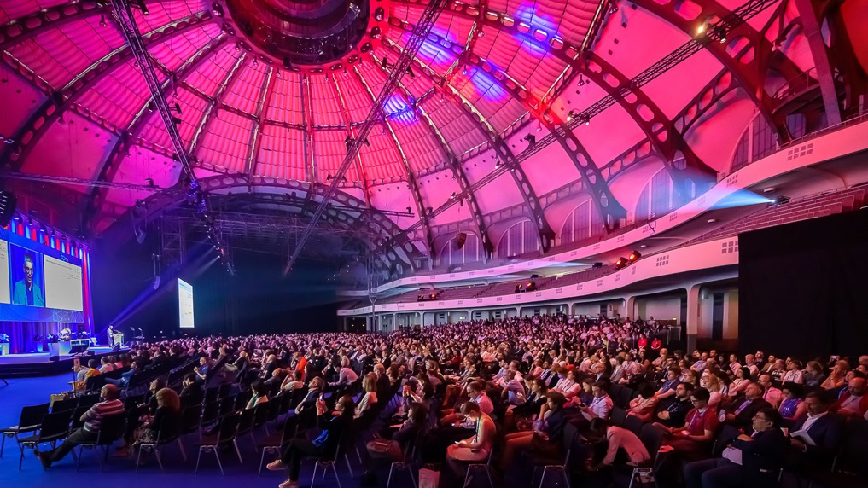
Objectives
EHA engagement with UEMS is focused on dual objectives:
Hematology specialty recognition
Hematology acknowledged as a unified specialty by UEMS
Joint accreditation EACCME-EBAH
CME activities accredited from a regulatory perspective by EACCME for EBAH
Notes:
In July, initial discussions focused on dual objectives. UEMS recognized hematology as a specialty, and EACCME accredited scientific activities for EBAH. Original Content: Date: July · Initial discussions on dual objectives · UEMS recognizing hematology as a specialty · EACCME accrediting scientific activities for EBAH

Slide 16
Outcomes of meetings with UEMS
July 2024:
UEMS aims to expand collaboration with scientific societies and assist with EU specialty recognition, while EHA will share key documents.
October 2024:
Focus on collaboration for the dual objectives, recognizing hematology as a specialty, and joint EACCME-EBAH accreditation.
January 2025:
This was the UEMS Advisory Council on CME meeting where EHA was invited to participate –EACCME Interim Report, new partnerships, updates to accreditation criteria, and general topics like gender diversity were discussed.
Notes:
In July, initial discussions focused on dual objectives. UEMS recognized hematology as a specialty, and EACCME accredited scientific activities for EBAH. Original Content: Date: July · Initial discussions on dual objectives · UEMS recognizing hematology as a specialty · EACCME accrediting scientific activities for EBAH

Slide 17
Way forward
We continue to engage with UEMS and EACCME to achieve our dual objectives of hematology as a specialty recognition and co-accreditation of EBAH activities.
Notes:
This slide covers a summary of key points and decisions made, followed by the next steps which include future plans and actions. Original Content: Summary: · Recap of key points and decisions Next Steps: · Future plans and actions

Slide 18
Estimated Timelines
ETR Submission
Q3, 2025
EACCME
Q3, 2025
Objective 1 – Specialty recognition
Objective 2 – Joint accreditation
MOU signing
Q1, 2026
MOU signing
Q1, 2026
Notes:
This slide covers a summary of key points and decisions made, followed by the next steps which include future plans and actions. Original Content: Summary: · Recap of key points and decisions Next Steps: · Future plans and actions

Slide 19
Latest updates
Objective 1 – Specialty recognition
Objective 2 – Joint accreditation
ETR drafting has been started, and a first draft will be shared with relevant stakeholders (Curriculum & Exam Committee, Education Committee)
EHA held a call with UEMS Microbiology to share their experience on medical microbiology that will help us with the submission of hematology as a unified specialty
EACCME has shared a draft of contract between EACCME-EBAH, this includes all activities including online learning, blended learning, and in person events
Contract draft has been shared with Margarita as the Board lead, and Peter as the EBAH Chair for comments and follow-up as required for the next steps

Slide 20
What we need from NS
Hematology recognised as a unified specialty (clinical, diagnostics)
What are your priorities or needs that could be addressed by recognition of hematology as a unified specialty by UEMS?
Joint accreditation EACCME-EBAH
What are your benefits and does this support your goals related to CME and learning?

Slide 22
EHA Career Mapping
Antonio Almeida
EHA President
February 2025

Slide 23
Career paths in hematology website
Objective: EHA wants to increase understanding of career paths in hematology by helping people to access clear, at-a-glance information for European countries.
Solution: Developed a new online tool that will enable anyone to view — and compare — the different tracks in Europe. We've created this tool to:
Make it easy for you to visualize how career paths in hematology differ across European countries
Promote harmonization of Hematology Education in Europe

Slide 24
Career paths in hematology website
The visualizations are based upon data that is:
• Provided by national societies across Europe
• Validated by national teaching coordinators in each country
https://eha.coolercode.nl/

Slide 26
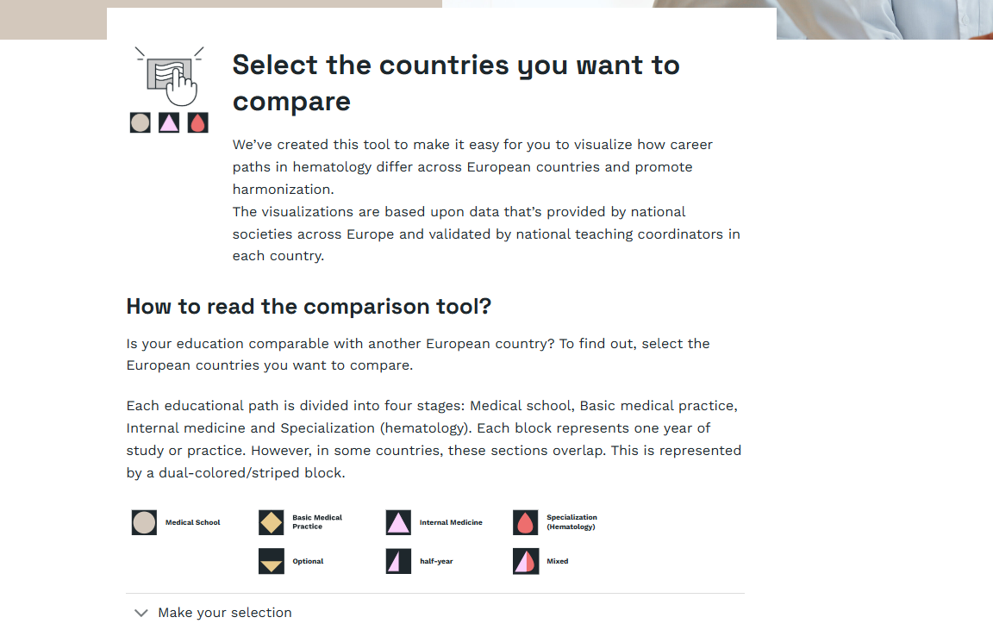

Slide 29
Next steps
Test environment launch of the website: End of February

