Slide 1
Albanian Association of Hematology –Europian Hematology Association
Alma Cili MD/PhD
EHA NS Day
February 13/14 /2025
Hague, Netherlands

Slide 2
Albanian Association of Hematology
Members 29
Joint members 6
EHA members 12

Slide 3
Continuing Medical Education
National Hematology Conference accredited by EBAH, November 2019
EHA- AAH Balkan Hematology mini-Tutorial, November 2021
EHA- AAH Balkan Hematology tutorial, April 2022
EHA- AAH Balkan Hematology Day, April 2024

Slide 4
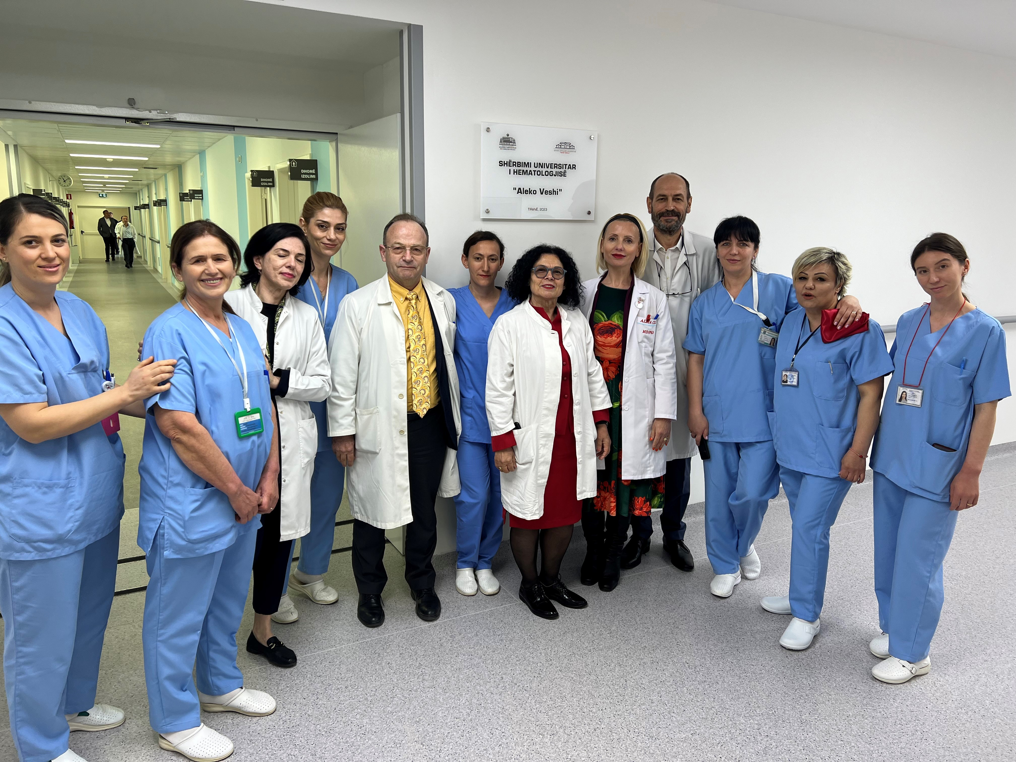

Slide 5
Thank you !

