Slide 1
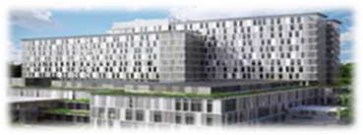
Success stories and best practices from Serbian Hematology society
The hematology section of the Serbian Medical Association, since its establishment in 1953, has played a huge role in the development of science, practice and in general the organization of the work of hematologists.
Today, there are about 200 members of doctors-hematologists, doctors in specialization and sub-specialization.
The Hematology Clinic in Belgrade, of the University Clinical Center of Serbia, is the largest hematology institution in Serbia and the region (especially in the territory of the former Yugoslavia).
In the last few years, actually about 10 years ago, we have been committed to the following goals within hematology:
Introduction into daily clinical practice of new diagnostic methods (PCR, FISH, multi-color flow cytometry - about 10 years ago) to NGS (from 2024) for precise diagnosis of all hematological malignancies (acute leukemia, multiple myeloma, myeloproliferative neoplasms, lymphoma, chronic lymphocytic leukemia...
Advocacy for the availability of as many drugs as possible, from the group of target therapy, monoclonal antibodies, immunomodulatory drugs, new generation of cytostatics (Hypomethylation agents, venetoclax) - some through the so-called positive lists or through other regulatory mechanisms „of lable“ or article 9-salaries of the Republic Health Insurance Fund)
Updating and supplementing therapeutic guidelines for 2 years for all hematological diseases (malignant and benign)
Participation in international studies for all hematological diseases, for example for acute leukemias, the REGAL study for relapsed AML was recently completed; our center has just been accepted for a new study for R/R AML, High risk MDS:
Continuous education of hematologists at the Clinic for Hematology, as well as for all hematologists in Serbia and in the region, especially from Montenegro, Republika Srpska, Bosnia and Herzegovina, North Macedonia). Forms of education are national congresses, thematic professional meetings and symposia.
EHA NS Day on February 13 and 14, The Hague,The Netherlands

Slide 2
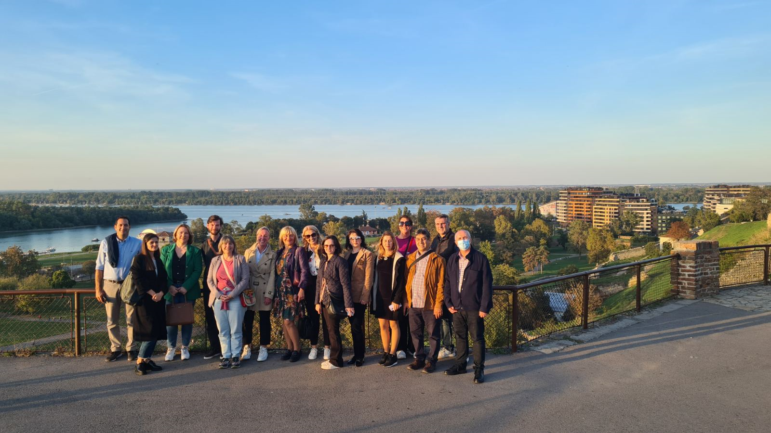
What we would like in the near future: We would like even more intensive cooperation with EHA
4th EHA Balkan Day, oktober 2023, Belgrade
We organized the 4th EHA Balkan Day in October 2023, with a focus on acute leukemia
An EHA tutorial dedicated to benign hematology is planned, in Belgrade, September 2025
Participation of young hematologists at the EHA EXAM May, 2025
Special involvement of young hematologists in multifaceted activities within the EHA program
Several of our hematologists have been abstract reviewers for EHA congresses (for acute leukemias, multiple myeloma, myeloproliferative neoplasms) - we would like to continue this as it is a valuable experience
We would especially emphasize that the increasingly intensive cooperation with EHA is of great benefit to us, giving us new ideas and a wind at our back towards our main goal:
Better and more comprehensive staff education
Application of international experiences in the publication of scientific works, participation in congresses and
Development of personalized precision medicine for our hematology patients

Slide 3
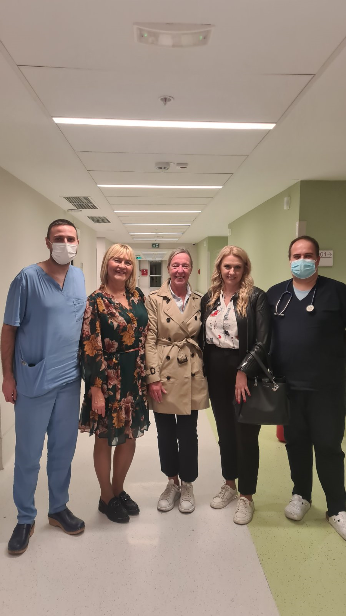
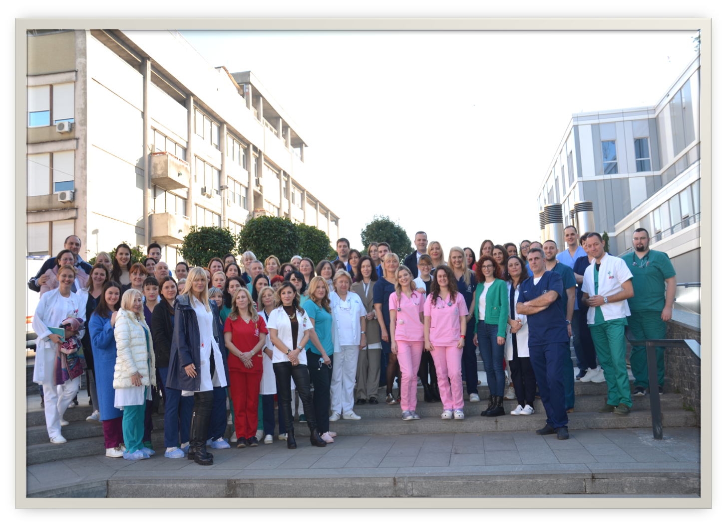
Warm greetings from the Clinic for Hematology!
Tour of the New Clinical Center, during the EHA Balkan Day break,
with dear Prof. Konstanze and the doctors on duty

