Slide 1
Dutch Society Hematology
Chair: Stijn Halkes Chair (Leiden University Medical Center)
Secretary: Annoek Broers (Erasmus University Medical Center)
Treasurer: Jeroen Janssen (Radboud University Medical Center)
637 members: 373 Hematologists, 39 trainees, researchers, specialized nurses, other specialists in internal medicine
Representing Dutch Hematologists to goverment, pharmaceutical industry, patient organisations
Strong collaboration with HOVON (focus on research)
Organization of Dutch Hematology Congress (3 days, 800 visitors, no sponsoring) 2025 January

Slide 2
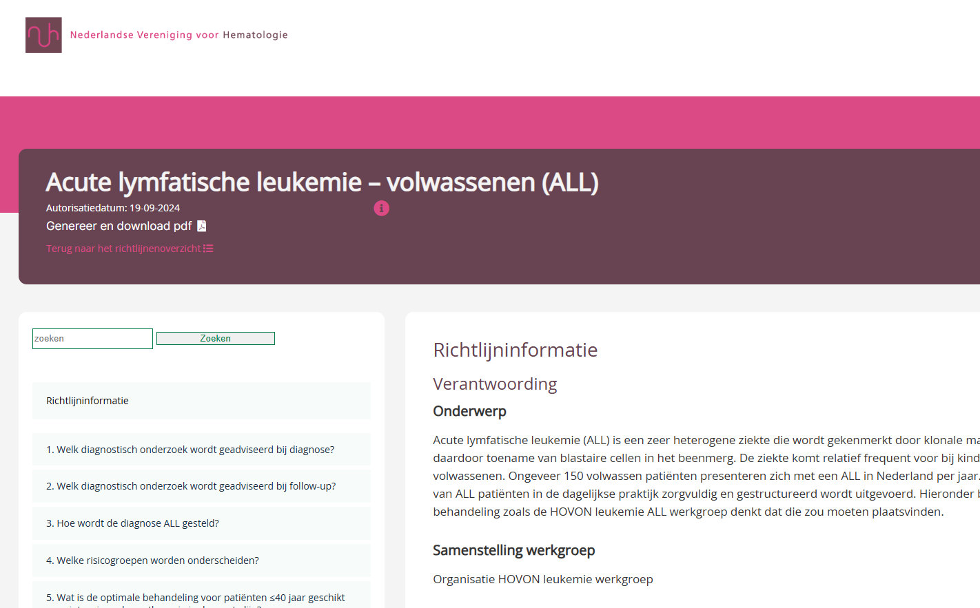
Success stories and best practices
Digital tool for Up-to-Date national guidelines for diagnosis and treatment for both malignant and non-malignant hematological diseases. These can be updated per module.
‘

