Slide 1
Slovenian Hematology Association (ZHS)

Slide 2
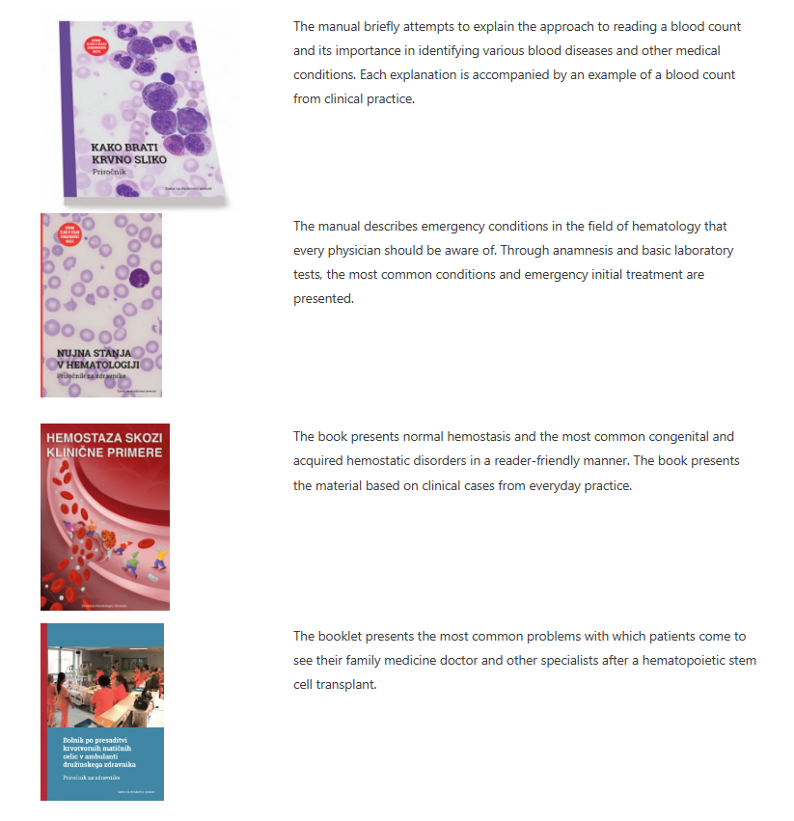
Educational and scientific initiatives
Publications for professionals

Slide 3
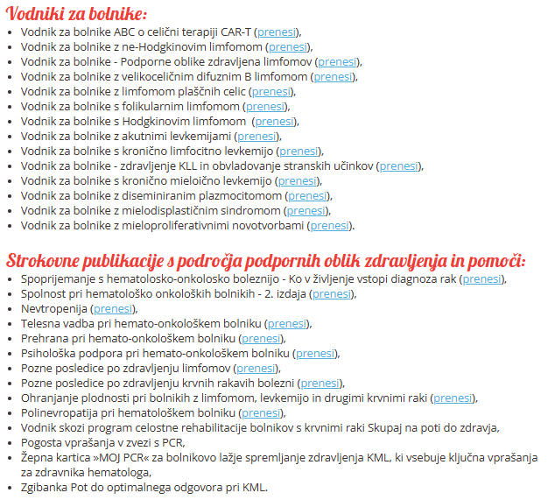
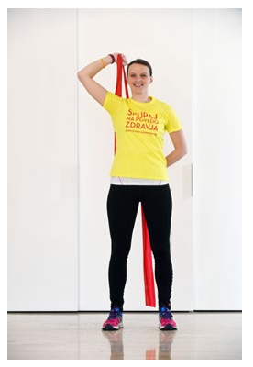
Collaboration with Patient Support Groups
Informational Booklets for patients
Comprehensive rehabilitation program
„Together on the path to health“

