Slide 1
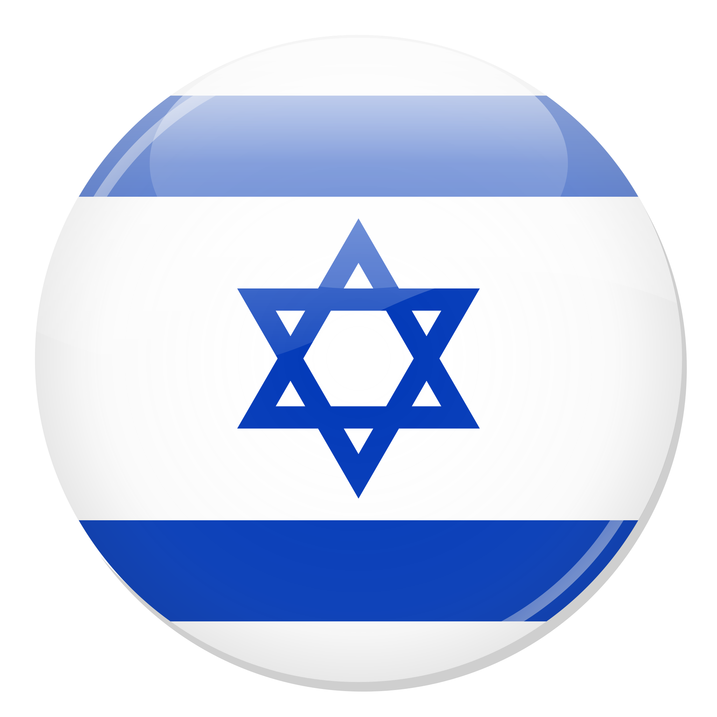
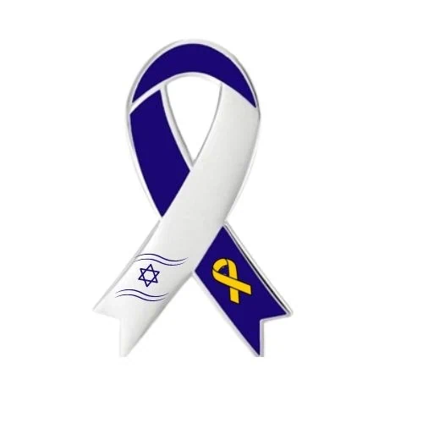
The Israeli Society of Hematology and Blood Transfusion
Chairperson: Dr. Netanel Horowitz
Membership: 280 physicians
The society is part of the Israeli Medical Association.
It includes 10 working groups, each focused on common hematologic diseases.

Slide 2
Annual Research Grants:
Basic research
Clinical research

Slide 3
Training Workshops and Board Exam Preparation for Hematology Fellows
Lectures by leading experts in Israel
Bone marrow aspirates interpretation
Communication skills with patients

Slide 4
Consultation for the Israeli Health Basket Committee
Prioritization of new hematology drugs each year
Ongoing advisory role during committee discussions

