Slide 1
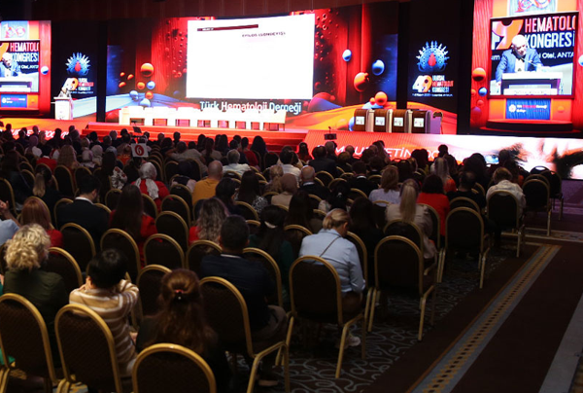
Turkish Society of Hematology
2024
www.thd.org.tr

Slide 2
Priorities
04
EDUCATION:
Turkish Haematology Academy: 6 mo ‘Rising Star’ Training Programme for young haematologists (Stem Cell Transplantation in 2024)
2. Turkish School of Haematology: 3 year course consisting of
12 modules for haematology fellows based on European
Curriculum
3. Online Education: 15 webinars, 10 Podcasts in 2024
4. Small-group Education: 4 courses
GRANTS (2024):
Research Grants: 3 Projects
Merit Scholorships: 12 Fellows
Travel Grants: 32 Fellows
www.thd.org.tr

Slide 3
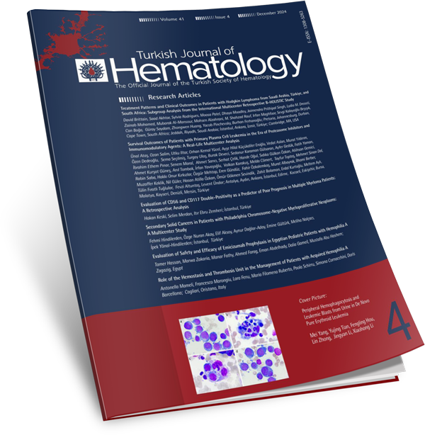
Events
05
SCIENTIFIC MEETINGS (2024):
50th National Hematology Congress
9th International Congress on Leukemia, Lymphoma Myeloma
16th National Bone Marrow Transplantation and Cellular Therapies Congress
UPDATED NATIONAL HEMATOLOGY GUIDELINES
TURKISH JOURNAL OF HEMATOLOGY since 1951
(indexed in SCIE)
www.thd.org.tr

Slide 4
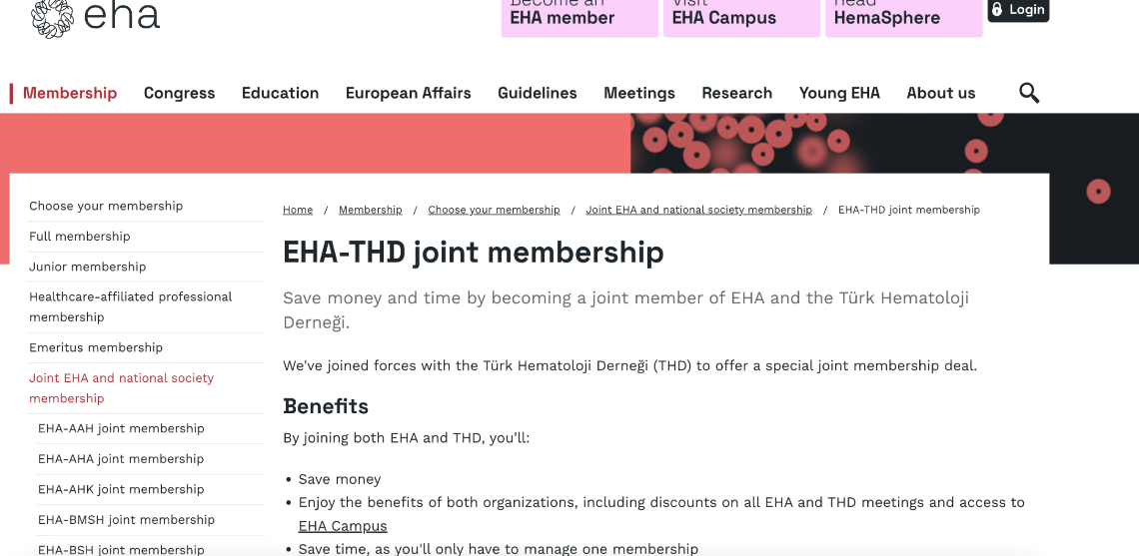
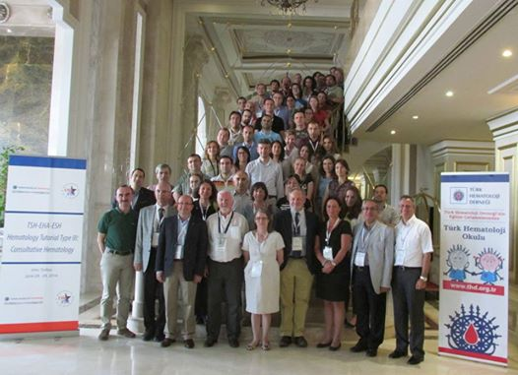
Success Stories
07
Council for Evaluation and Accreditation of Haematology Education Programmes and Haematology Board Certification
Haematology Programmes were accredited at 7 centres countrywide
Board Certification:
Written Exam (EHA Board Exam is recognised)
Practical Exam
EHA-THD Joint Membership
Joint EHA Tutorial (La Cantera) for fellows
EHA-THD JOINT SESSION at National Meeting
www.thd.org.tr

Slide 5
Thank You
thd@thd.org.tr
www.thd.org.tr

