Slide 1
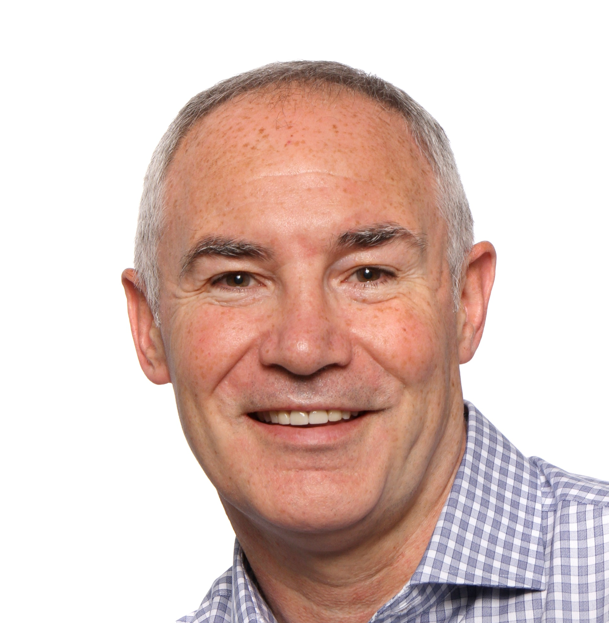
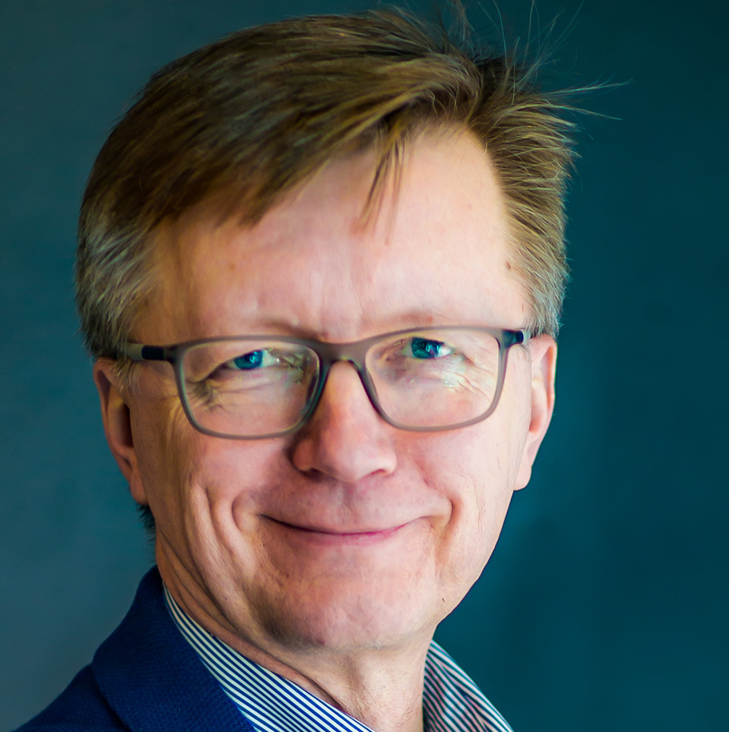
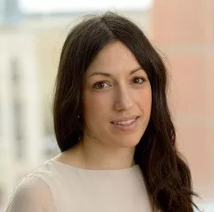
EHA-SfPM Precision Medicine Meeting
Keynote speakers
Brian Huntly
Olli Kallioniemi
Elli Papaemmanouil
Uniting genomic and functional precision medicine, empowering hematological and solid-tumor researchers to enhance precision medicine for cancer patients.
What you can enjoy at the meeting:
Share across communities
Exchange experiences between genomic and functional precision medicine.
September 25-27, 2024
Learn across fields
Tackle challenges in one field with expertise from another.
Copenhagen, Denmark
Stay up to date on advancements
Explore new advancements demonstrated in functional precision medicine.

