Slide 1
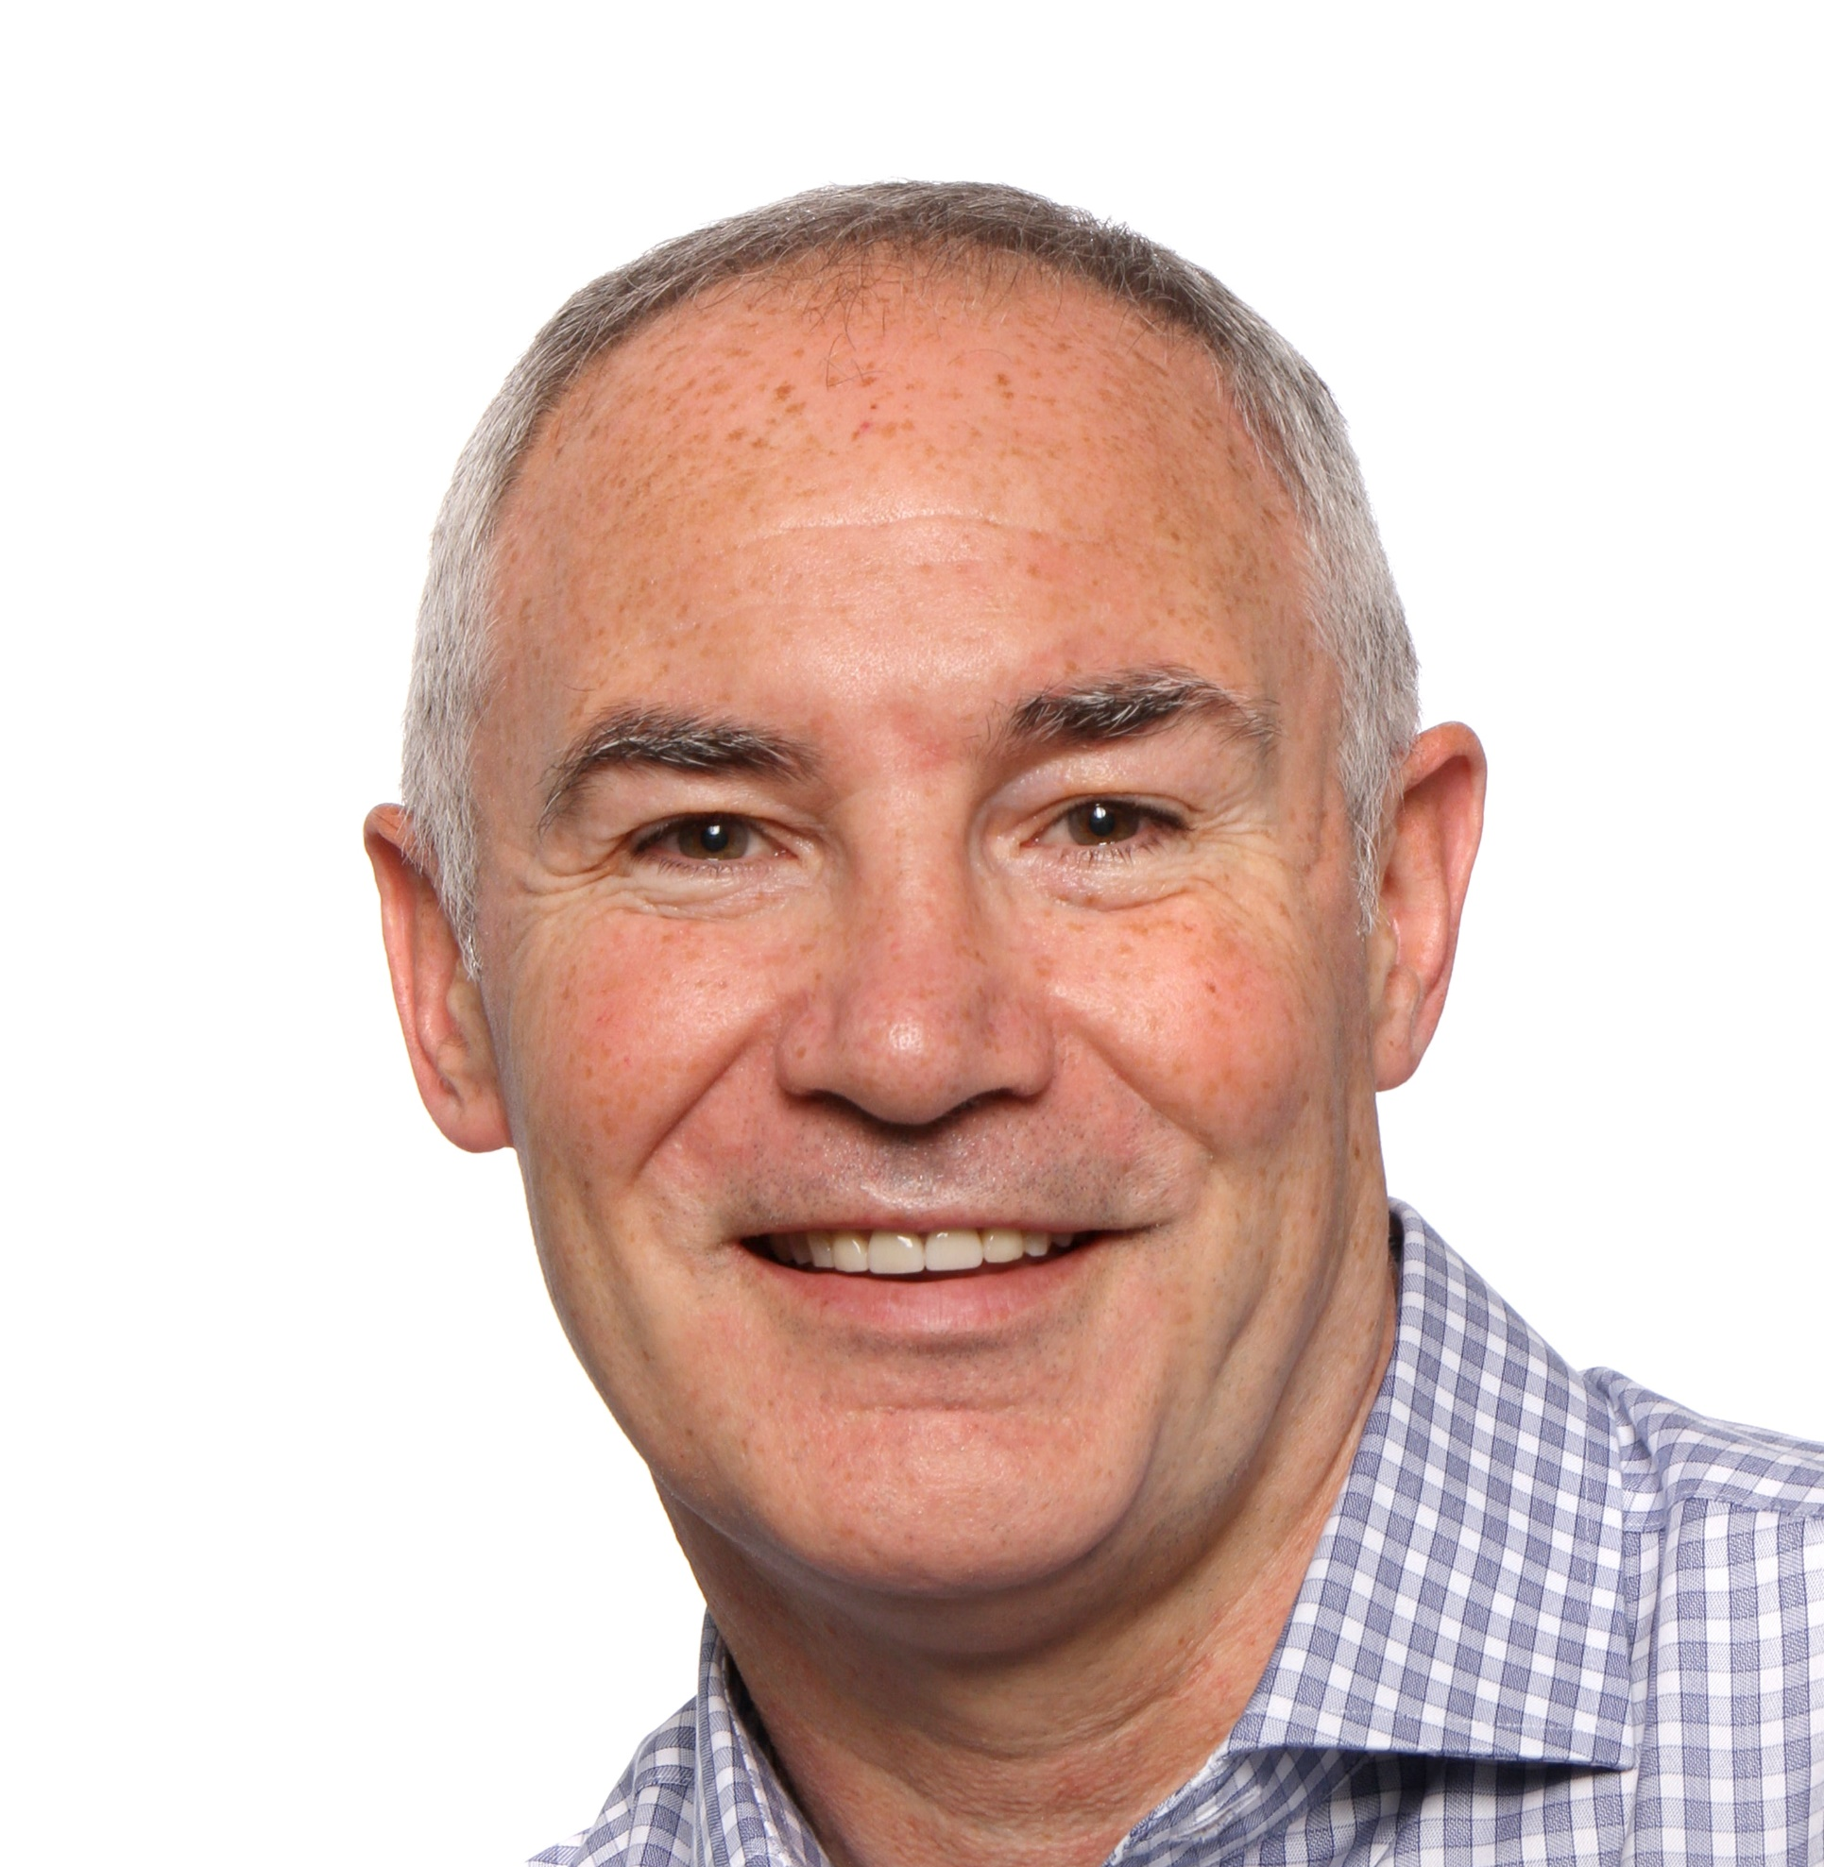
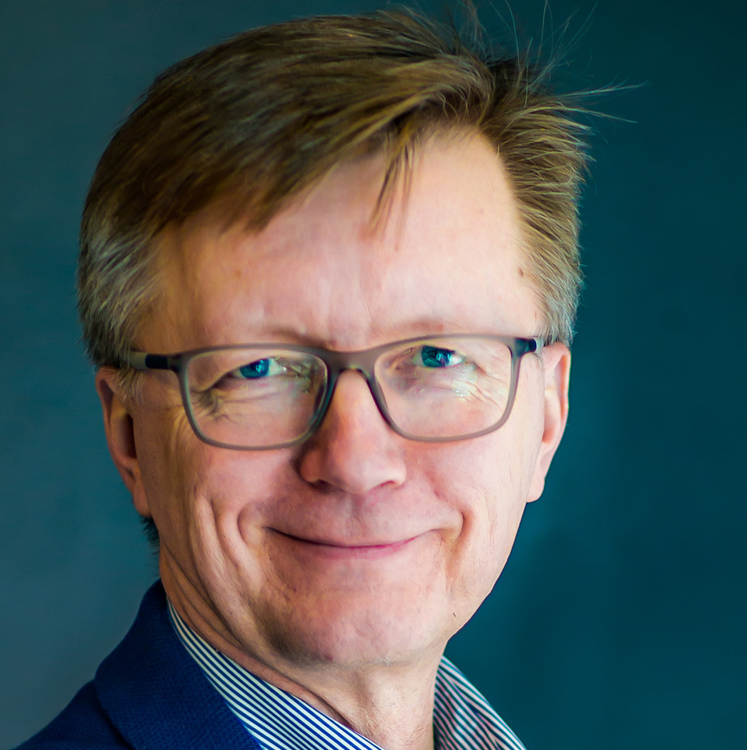
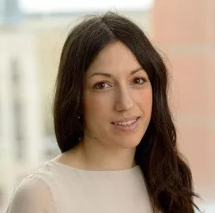
Keynote speakers
EHA-SfPM Precision Medicine Meeting
Uniting genomic and functional precision medicine, empowering hematological and solid-tumor researchers to enhance precision medicine for cancer patients.
Brian Huntly
Olli Kallioniemi
Elli Papaemmanouil
September
25-27, 2024
Copenhagen,
Denmark
What you can enjoy at the meeting:
Share across communities
Exchange experiences between genomic and functional precision medicine.
Scan for more information
Learn across fields
Tackle challenges in one field with expertise from another.
Stay up to date on advancements
Explore new advancements demonstrated in functional precision medicine.

