Slide 1
EHA-ISHBT Hematology Tutorial
Clinical Case – Session […]
Speaker:
Hyderabad, India
March 1-3, 2024

Slide 2
Clinical history
A 44-year-old man underwent orthotopic cardiac transplantation for dilated cardiomyopathy
At surgery his blood count and blood film were normal
Immunosuppression was induced with rabbit anti-thymocyte globulin and maintained with ciclosporin, azathioprine and prednisolone
His other medications were co-trimoxazole, aciclovir, nystatin, and aspirin.

Slide 3
Clinical history
One month post-transplant he developed an episode of graft rejection, which responded to pulses of intravenous methylprednisolone
Mild rejection persisted, however, and azathioprine was replaced by mycophenolate mofetil (initial dose, 1.5 g b.d.)

Slide 4
Clinical history
Despite maintaining plasma levels of the drug at between 1 and 3 mg/ml, he developed a further episode of rejection
Methylprednisolone was given again and the dose of mycophenolate mofetil was increased to 2 g twice daily
His cardiac status improved

Slide 5
Clinical history
Four months after commencing mycophenolate his previously stable blood count showed
Haemoglobin concentration (Hb) 107 g/l
WBC 4.23 x 10⁹/l
Neutrophils 3.53 x 10⁹/l
Platelet count 157 x 10⁹/l
The blood film became abnormal
Plasma mycophenolate level was considered satisfactory at 1.9 mg/ml and the drug was continued at a dose of 2 g b.d.

Slide 6
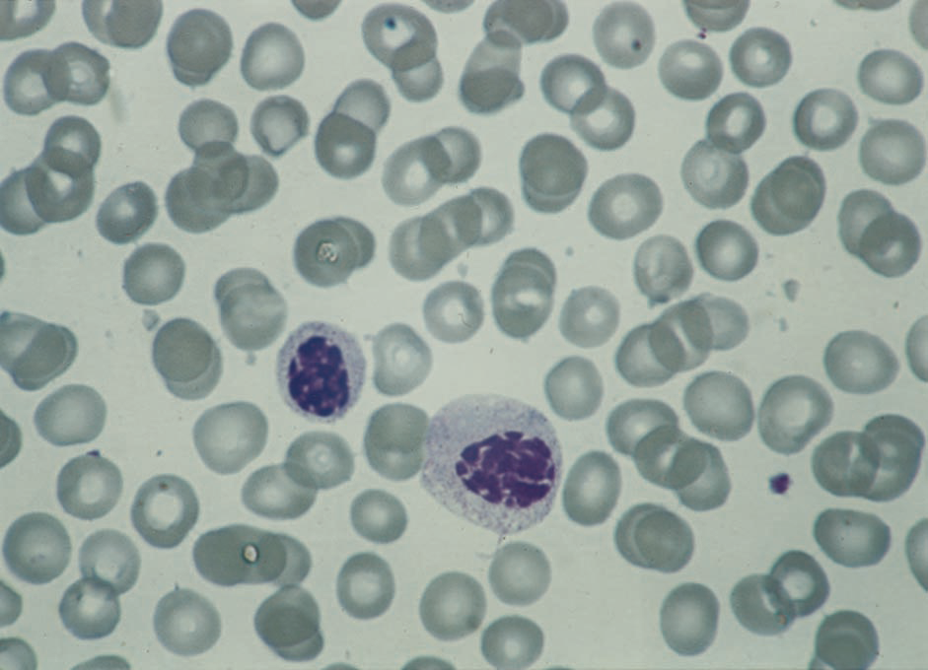
Blood film
From Banerjee et al. (2000) Transplantation, 70, 1608

Slide 7
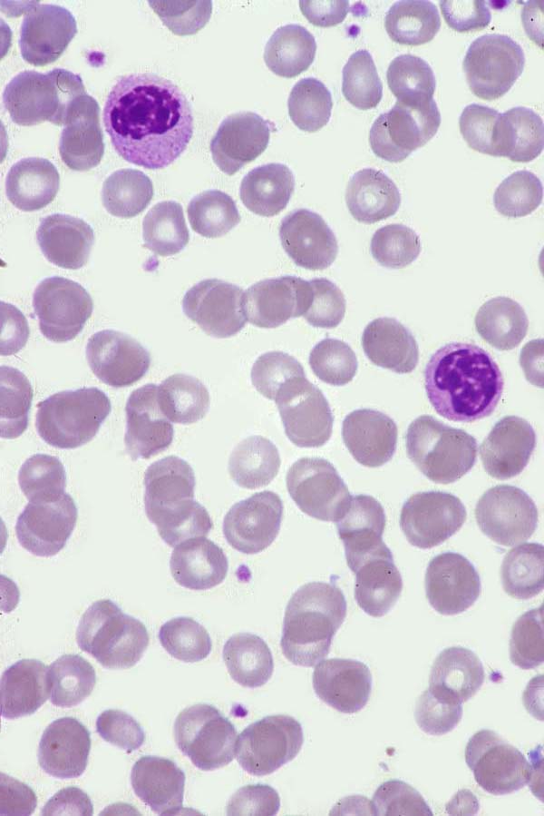
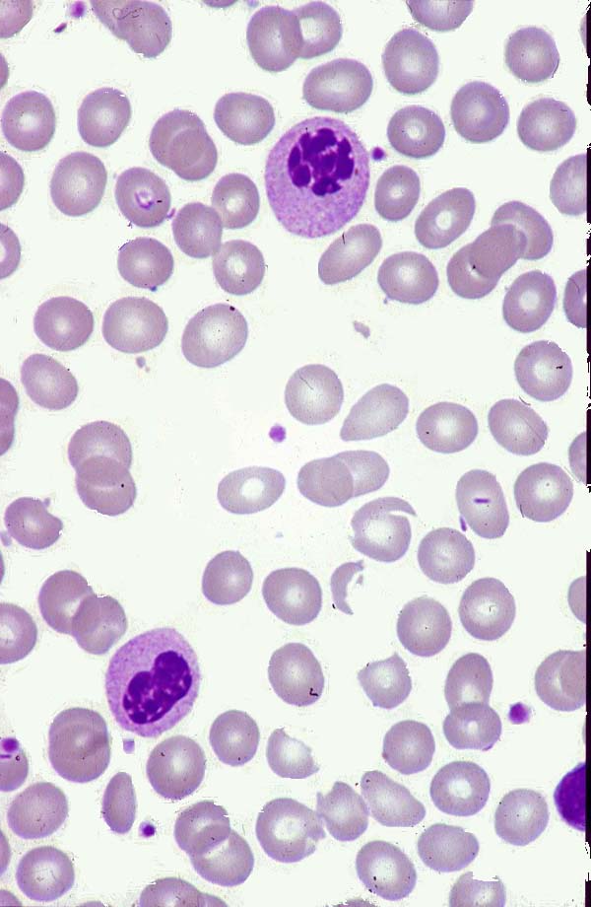
Blood film
From Bain, Blood Cells, 4th edn, 2006
From Bain, Clark and Wilkins, Bone Marrow Pathology, 4th edn, 2010

Slide 8
Clinical history
Two months later the plasma level of mycophenolate mofetil had risen to 4.7 mg/ml
The neutrophil count had fallen to 1.43 x 10⁹/l
Almost all of his circulating neutrophils appeared markedly dysplastic
A bone marrow aspirate was hypocellular, with abnormal clumping of chromatin at all phases of myeloid development beyond the promyelocyte stage
There were very few neutrophils

Slide 9
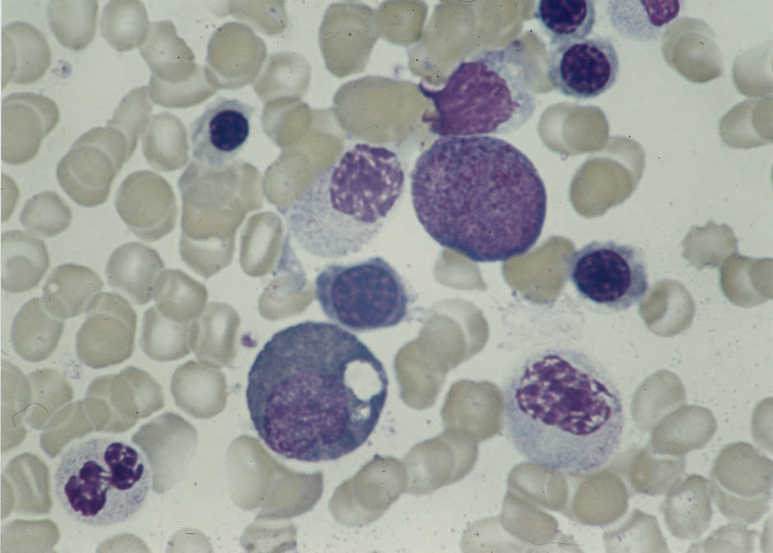
Bone marrow aspirate
From Banerjee et al. (2000) Transplantation, 70, 1608.

Slide 10
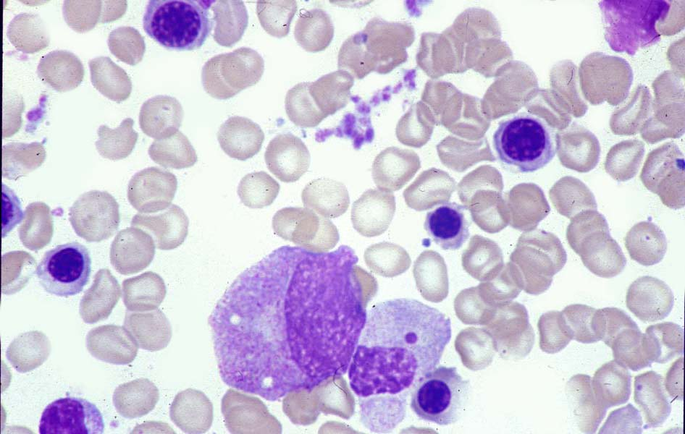
Bone marrow aspirate
From Bain, Clark and Wilkins, Bone Marrow Pathology, 4th edn, 2010

Slide 11
Clinical history
Mycophenolate was discontinued and became undetectable in plasma after 1 week
After 6 weeks
Hb 120 g/l
Neutrophil count 4.3 x 10⁹/l
Neutrophil morphology normal
He remained well 18 months after transplantation

Slide 12
Reference
Banerjee R, Halil O, Bain BJ, Cummins D and Banner NR (2000) Neutrophil dysplasia caused by mycophenolate mofetil. Transplantation, 70, 1608-1610.

Slide 13
Discussion
Another patient reported in the same paper also developed neutrophil dysplasia while on mycophenolate mofetil following heart–lung transplantation
This was followed by leucopenia,
WBC 2.0 x 10⁹/l
Neutrophils 1.4 x 10⁹/l
On stopping mycophenolate mofetil, the WBC rose to 4.6 by day four
Morphology was normal by 4 weeks

Slide 14
Discussion
Other cases have subsequently been reported
Kennedy et al. reported five cases of drug-related dysplasia, three of whom then developed neutropenia (neutrophils 1.0 x 10⁹/l), following renal transplantation
All patients were taking mycophenolate mofetil, gancliclovir, cotrimoxazole and prednisolone
Reversed on stopping or reducing dose of both mycophenolate and ganciclovir
Kennedy et al (2002) Neutrophil dysplasia characterised by a pseudo-Pelger–Huet anomaly occurring with the use of mycophenolate mofetil and ganciclovir following renal transplantation: a report of five cases. Pathology, 34, 263.

Slide 15
Discussion
Kennedy et al (2002) Neutrophil dysplasia characterised by a pseudo-Pelger–Huet anomaly occurring with the use of mycophenolate mofetil and ganciclovir following renal transplantation: a report of five cases. Pathology, 34, 263.

Slide 16
Discussion
Asmin et al. reported three patients with transplants of liver, pancreas/kidney and kidney respectively
All were taking tacrolimus, mycophenolate mofetil and prednisolone when they developed dysplasia – hypolobulation and chromatin clumping
One patient resembled homozygous Pelger-Huët anomaly, two resembled the heterozygous anomaly
All reversed on drug withdrawal (1 patient) or dose reduction (2 patients) with no alteration in tacrolimus dose

Slide 17
Discussion
On mycophenolate
Not on mycophenolate
Asmis et al (2003)Acquired and reversible Pelger-Huët anomaly of polymorphonuclear neutrophils in three transplant patients receiving mycophenolate mofetil therapy. Am J Hematol, 73, 244.

Slide 18
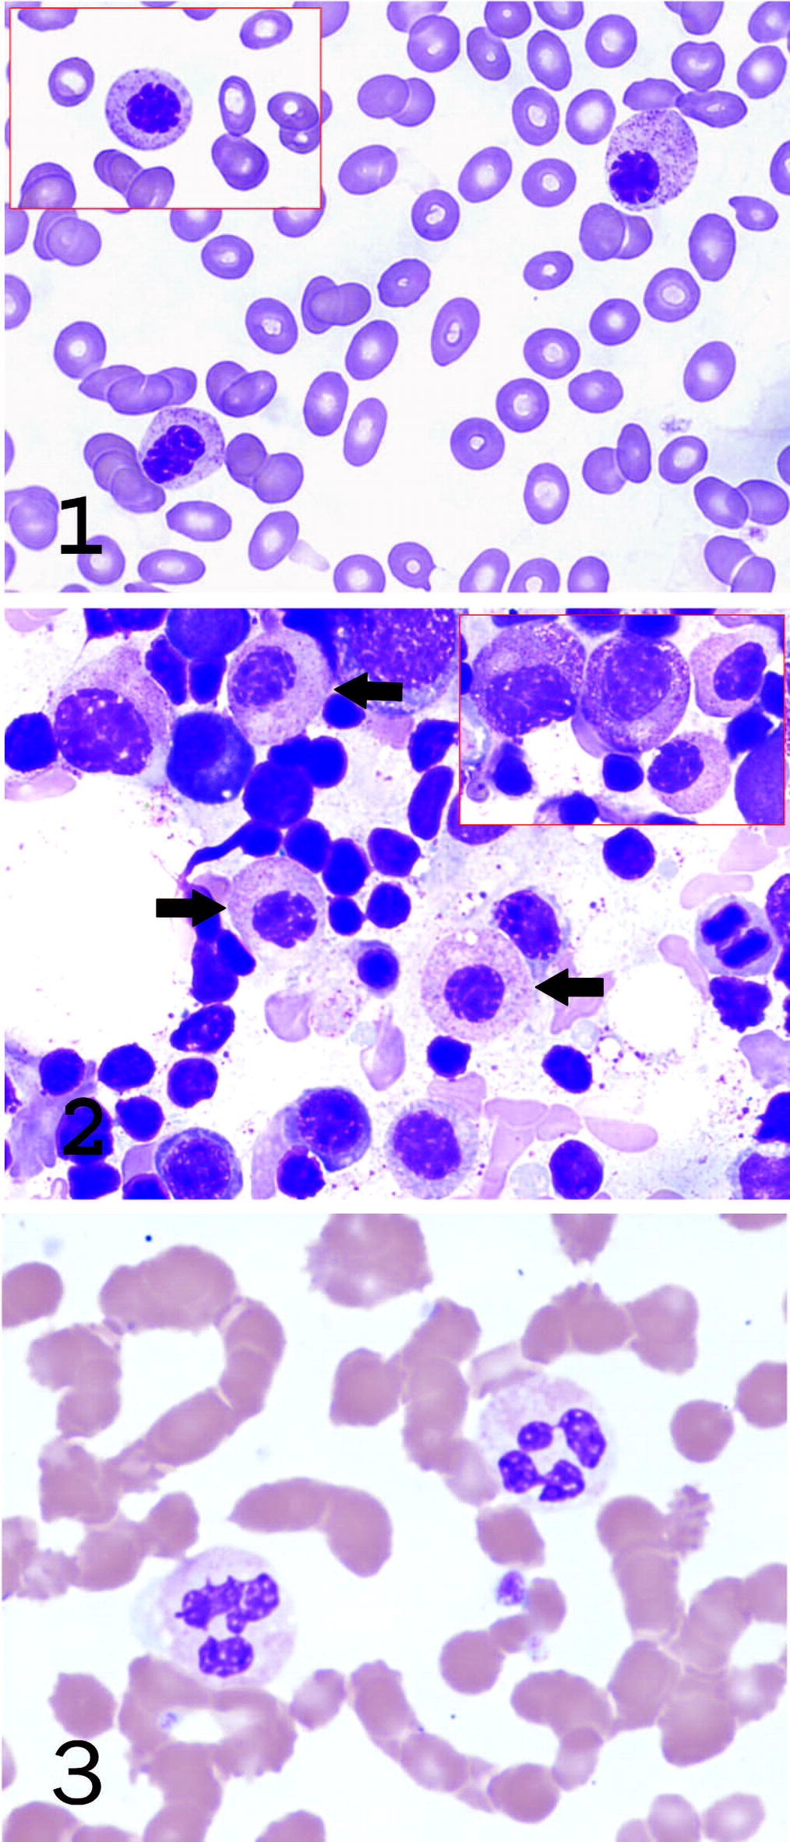
Discussion
Etzel and wang reported a liver transplant patient on mycophenolate mofetil and tacrolimus
Dysplasia developed and reversed on reduction of mycophenolate dose
Etzel and Wang (2003) Acquired Pelger-Huët anomaly in association with concomitant tacrolimus and mycophenolate mofetil in a liver transplant patient. Arch Pathol, 130, 93.

