Slide 1
EHA Tutorials ‒ Some Pitfalls to Avoid
Professor Barbara Bain (tutorial editor)

Slide 2
Purpose of this presentation
This short presentation deals with common mistakes in presentations for tutorials
We hope you will find it helpful

Slide 3

Do you ever make a mistake?
Perhaps yes

Slide 4

Not convinced?
What about this one?

Slide 5
Pitfalls that occur in both tutored cases and self-evaluation cases

Slide 6
Further tests
FBC: Hb 122 g/l, RBC 4.18 × 1012/l, PLT 192 × 109/l, WBC 52.1 × 109/l, lymphocytes 90%
Biochemistry: serum glucose 5.5 mmol/l, bilirubin 13.3 μmol/l, AST 27.5 u/l, ALT 24.7 u/l, CRP 10 mg/l
What is wrong with this screen?

Slide 7
Further tests
FBC: Hb 122 g/l, RBC 4.18 × 1012/l, PLT 192 × 109/l, WBC 52.1 × 109/l, lymphocytes 90%
Biochemistry: serum glucose 5.5 mmol/l, bilirubin 13.3 μmol/l, AST 27.5 u/l, ALT 24.7 u/l, CRP 10 mg/l
Unexplained abbreviations

Slide 8
Immunophenotyping
AE1/3-negative,
CD3-negative in tumor HRS-«like cells», expressed + membrane reaction in T lymphocytes,
CD11c-negative in all the cells,
CD15 positive membrane reaction and Golgi area reaction disseminated «HRS-like»,
CD20 negative reaction in tumor HRS-like cells, expressed membrane reaction in B lymphocytes,
CD30 positive membrane in Golgi area reaction in disseminated «HRS-like» tumor cells,
CD34 negative in tumor cells, +membrane reaction in blast cells,
CD43-negative in «HRS-like» tumor cells, + membrane reaction in tumor cells,
CD56-negative in tumor cells,
CD61-positive membrane reaction in disseminated megakaryocytes
CD68-positive/negative membrane reaction in single monocytesCD79a-negative in «HRS-like» , expressed membrane reaction in lymphocytes
Cd117 negative in tumor cells positive membrane reaction in single disseminated cells
Cd138-negative in tumor cells, positive membrane reaction in single disseminated cells
KAPPA-negative in neoplastic cells
LAMBDA-negative in neoplastic cells
Ki67-70.5%
Conclusion. Classical Hodgkin Lymphoma mixed cellularity CD30+, CD15+/-, Cd45-, PAX+/-, CD20-?+, Cd79a-/+, EBER+/-, OCT-2/+., BOB.1-/+
What is wrong with this screen?

Slide 9
Immunophenotyping
AE1/3-negative,
CD3-negative in tumor HRS-«like cells», expressed + membrane reaction in T lymphocytes,
CD11c-negative in all the cells,
CD15 positive membrane reaction and Golgi area reaction disseminated «HRS-like»,
CD20 negative reaction in tumor HRS-like cells, expressed membrane reaction in B lymphocytes,
CD30 positive membrane in Golgi area reaction in disseminated «HRS-like» tumor cells,
CD34 negative in tumor cells, +membrane reaction in blast cells,
CD43-negative in «HRS-like» tumor cells, + membrane reaction in tumor cells,
CD56-negative in tumor cells,
CD61-positive membrane reaction in disseminated megakaryocytes
CD68-positive/negative membrane reaction in single monocytesCD79a-negative in «HRS-like» , expressed membrane reaction in lymphocytes
Cd117 negative in tumor cells positive membrane reaction in single disseminated cells
Cd138-negative in tumor cells, positive membrane reaction in single disseminated cells
KAPPA-negative in neoplastic cells
LAMBDA-negative in neoplastic cells
Ki67-70.5%
Conclusion. Classical Hodgkin Lymphoma mixed cellularity CD30+, CD15+/-, Cd45-, PAX+/-, CD20-?+, Cd79a-/+, EBER+/-, OCT-2/+., BOB.1-/+
The font is too small
Slides must be legible from the back of the room
There are a few typographical errors

Slide 10
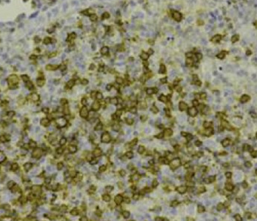
Immunohistochemistry of lymph node
What is wrong with this screen?

Slide 11
Immunohistochemistry of lymph node
We don’t know the antibody specificity

Slide 12
Clinical history
Diagnosis: Chronic Lymphocytic Leukemia IIB stage
  Treatment: Leukeran 2 mg daily .
After 2 weeks WBC count was decreased to 40 × 109/l.
After 4 weeks – 57 × 109/l.
  Leukeran was given again and the dose was increased to 4 mg daily
After 10 months WBC count 40.0 – 60.0 × 109/l
Hb and PLT were normal
What is wrong with this screen?

Slide 13
Clinical history
Trade name has been used
Use only generic names
Diagnosis: Chronic Lymphocytic Leukemia IIB stage
  Treatment: Leukeran 2 mg daily .
After 2 weeks WBC count was decreased to 40 × 109/l.
After 4 weeks – 57 × 109/l.
  Leukeran was given again and the dose was increased to 4 mg daily
After 10 months WBC count 40.0 – 60.0 × 109/l
Hb and PLT were normal

Slide 14
Further tests
FBC: Hb 122 g/l, RBC 4.18 × 1012/l, PLT 192 × 109/l, WBC 52.1 × 109/l, lymphocytes 90%,
Biochemistry: serum glucose 5.5 mmol/l, creatinine 103, bilirubin 13.3
What is wrong with this screen?

Slide 15
Further tests
FBC: Hb 122 g/l, RBC 4.18 × 1012/l, PLT 192 × 109/l, WBC 52.1 × 109/l, lymphocytes 90%,
Biochemistry: serum glucose 5.5 mmol/l, creatinine 103, bilirubin 13.3
Missing units
Missing units

Slide 16
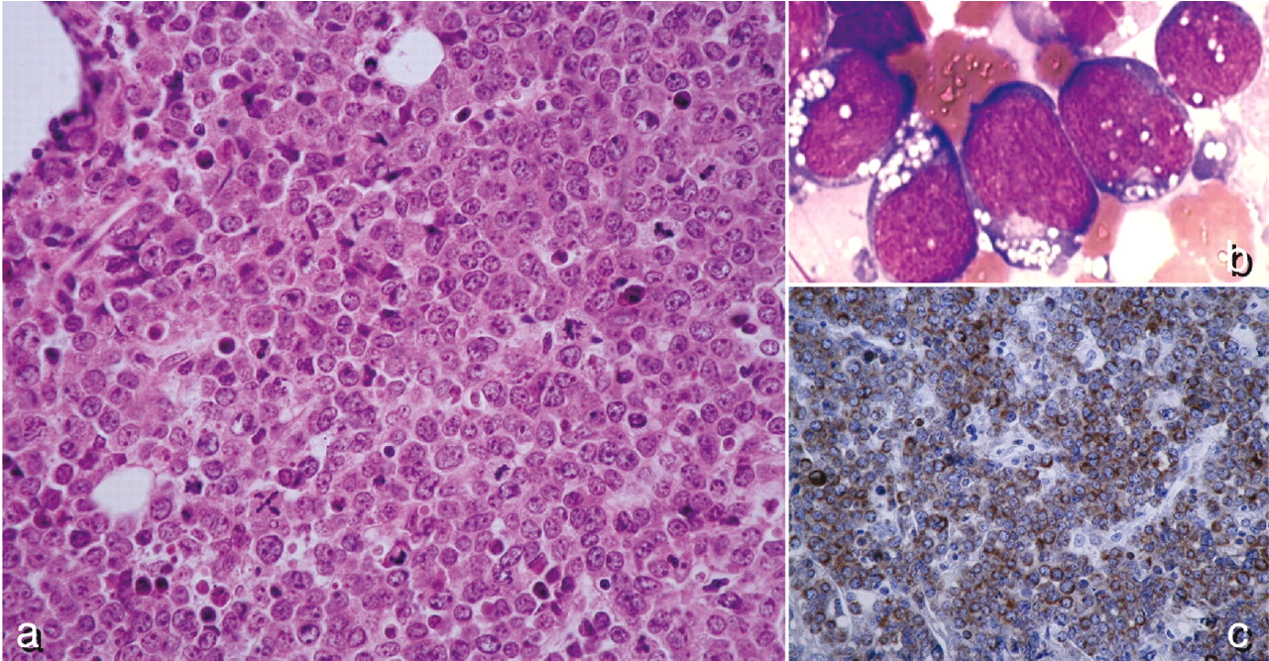
Histology at presentation
What is wrong with this screen?

Slide 17
Histology at presentation
It is not the case presented
It is a published case used without acknowledgement
It is from Le Gouill et al. (2007) Haematologica, 92, 1335.

Slide 18
Further tests
FBC: Hb 122 g/l, RBC 4.18 × 1012/l, PLT 192,0 × 109/l, WBC 52,15×109/l, lymphocytes 90%
What is wrong with this screen?

Slide 19
Further tests
FBC: Hb 122 g/l, RBC 4.18 × 1012/l, PLT 192,0 × 109/l, WBC 52,15×109/l, lymphocytes 90%
Random use of decimal commas

Slide 20
Further tests
FBC: Hb 122 g/dl
RBC 4.18 × 10^12/l
PLT 192,000/mm3
WBC 52.1 × 109/l
WBC 4.6 K/ul
Lymphocytes 9 × 109/l
What is wrong with this screen?

Slide 21
Further tests
Wrong
This is /l
Almost everything
FBC: Hb 122 g/dl
RBC 4.18 × 10^12/l
PLT 192,000/mm³
WBC 52.1 × 109/l
WBC 4.6 K/ul
Lymphocytes 9 × 109/l
Wrong
Wrong
Wrong
Wrong
Right!
Use only SI units

Slide 22
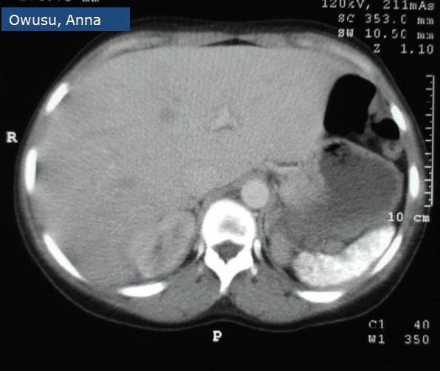
CT of abdomen
Splenic calcification
What is wrong with this screen?

Slide 23
CT of abdomen
Splenic calcification
The patient’s name is legible
Protect your patient’s privacy ‒ no names, no initials

Slide 24
Anaplastic large cell lymphoma: ALK-positive versus ALK-negative
International peripheral T cell and NK/T cell lymphoma study
Can we improve this screen?
Savage 2008

Slide 25
Anaplastic large cell lymphoma: ALK-positive versus ALK-negative
International peripheral T cell and NK/T cell lymphoma study
Better to give a more complete reference so that participants can note it down and find it
Savage et al 2008 Blood, 111, 5496
Savage 2008

Slide 26
Specific pitfalls in self-evaluation cases

Slide 27
Q1) Pomalidomide for relapsed multiple myeloma. Which is the standard dosage?
6mg/d days1-15
6mg/d days 1-21
4md/d days 1-15
4mg/d days1-21
2mg/d days 1-15
2mg/d days 1-21
What is wrong with this screen?

Slide 28
Q1) Pomalidomide for relapsed multiple myeloma. Which is the standard dosage?
6mg/d days1-15
6mg/d days 1-21
4md/d days 1-15
4mg/d days1-21
2mg/d days 1-15
2mg/d days 1-21
There are 6 options
There must be 5 and 5 only

Slide 29
Q5) The usual mechanism of acquired haemoglobin H disease is
1. Deletion of two or three α genes
2. Hypermethylation of α gene promoters
3. Reversion to fetal type erythropoiesis
4. Acquired somatic mutation of the ATRX gene
5. Up-regulation of β gene expression
What is wrong with this screen?

Slide 30
Q5) The usual mechanism of acquired haemoglobin H disease is
1. Deletion of two or three α genes
2. Hypermethylation of α gene promoters
3. Reversion to fetal type erythropoiesis
4. Acquired somatic mutation of the ATRX gene
5. Up-regulation of β gene expression
The true answer has not been indicated.
Just make it a different colour so the information is available when it is uploaded
This is for the staff uploading the case. The participants will not see it.

Slide 31
Q2) Which of these statements is true of haemoglobin S?
Has decreased oxygen affinity
Has increased oxygen affinity
Is prone to crystalise
Is prone to polymerise
Occurs only in those of African descent
What is wrong with this screen?

Slide 32
Q2) Which of these statements is true of haemoglobin S?
This answer is also true
There must be only one true answer
Has decreased oxygen affinity
Has increased oxygen affinity
Is prone to crystalise
Is prone to polymerise
Occurs only in those of African descent

Slide 33
Q6) Which of these is not a correct statement?
Side scatter (SSC) and forward scatter (FSC) of the abnormal cells suggest that the abnormal population represents monocytes
The reduced SSC of the CD34-positive cells suggests that there are hypogranular neutrophils
The distorted SSC & FSC characteristics suggests that the sample was stored for too long before processing
The CD7 is expression on MPO-positive cells do not suggest that this is a mixed phenotype acute leukaemia
There is aberrant lymphoid antigen expression on both myeloblasts and maturing myeloid cells
What is wrong with this screen?

Slide 34
Q6) Which of these is not a correct statement?
Side scatter (SSC) and forward scatter (FSC) of the abnormal cells suggest that the abnormal population represents monocytes
The reduced SSC of the CD34-positive cells suggests that there are hypogranular neutrophils
The distorted SSC & FSC characteristics suggests that the sample was stored for too long before processing
The CD7 is expression on MPO-positive cells do not suggest that this is a mixed phenotype acute leukaemia
There is aberrant lymphoid antigen expression on both myeloblasts and maturing myeloid cells
It is a negative question
It is too complex

Slide 35
Q7) What is the most likely diagnosis?
Double hit lymphoma
Double expressor lymphoma
Diffuse large B-cell lymphoma, not otherwise specified
What is wrong with this screen?

Slide 36
Q7) What is the most likely diagnosis?
Double hit lymphoma
Double expressor lymphoma
Diffuse large B-cell lymphoma, not otherwise specified
It is question 7. There can only be six questions
There are only three options. Five is essential.

Slide 37

Good luck with avoiding pitfalls
Rural-fuels.com

Slide 38

This

