Slide 1
EHA-KCS Hematology Tutorial
Self-assessment Case – Session […]
Speaker:
Almaty, Kazakhstan
September 13-14, 2024

Slide 2
Introduction
xxxxx
xxxxx
NOTE: Please use a minimum font size of 20 for the text and a minimum of size 30 for the title.

Slide 3
Q1) EXAMPLE: What is most likely diagnosis?
xxx
xxx
xxx
xxx
xxx
NOTE: Please use a minimal font size of 20 for the answer options. Otherwise, the answers will not be readable from the back of the room

Slide 4
Q1) EXAMPLE: What is most likely diagnosis?
xxx
xxx
xxx
xxx
xxx
NOTE: Display the answer in green in a separate slide like this.

Slide 5
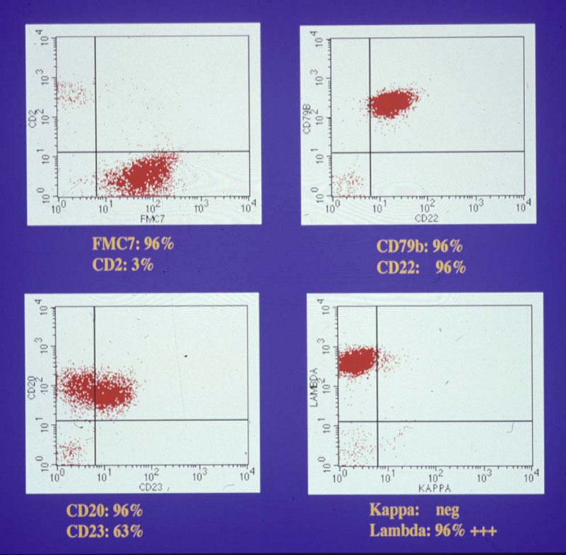
Fig. 1 Example of image
In addition the cells were CD5, CD10 and CD11c negative
NOTE: Please make sure your pictures including legends will be visible from the back of the room (minimal font size 18)

Slide 6
Q2)
xxx
xxx
xxx
xxx
xxx

Slide 7
Q2)
xxx
xxx
xxx
xxx
xxx
NOTE: Please make the correct answer a different color, in order to facilitate the conversion into an interactive presentation

Slide 8
More test results or pictures
XXXXXX
XXXXXX
NOTE: Please use a minimum font size of 20 for the text and a minimum of size 30 for the title.

Slide 9
Q3)
xxx
xxx
xxx
xxx
xxx

Slide 10
Q3)
xxx
xxx
xxx
xxx
xxx
NOTE: Please make the correct answer a different color, in order to facilitate the conversion into an interactive presentation

Slide 11
More test results or pictures
XXXXXX
XXXXXX
NOTE: Please use a minimum font size of 20 for the text and a minimum of size 30 for the title.

Slide 12
Q4)
xxx
xxx
xxx
xxx
xxx

Slide 13
Q4)
xxx
xxx
xxx
xxx
xxx
NOTE: Please make the correct answer a different color, in order to facilitate the conversion into an interactive presentation

Slide 14
More test results or pictures
XXXXXX
XXXXXX
NOTE: Please use a minimum font size of 20 for the text and a minimum of size 30 for the title.

Slide 15
Q5)
xxx
xxx
xxx
xxx
xxx

Slide 16
Q5)
xxx
xxx
xxx
xxx
xxx
NOTE: Please make the correct answer a different color, in order to facilitate the conversion into an interactive presentation

Slide 17
More test results or pictures
XXXXXX
XXXXXX
NOTE: Please use a minimum font size of 20 for the text and a minimum of size 30 for the title.

Slide 18
Q6)
xxx
xxx
xxx
xxx
xxx

Slide 19
Q6)
xxx
xxx
xxx
xxx
xxx
NOTE: Please make the correct answer a different color, in order to facilitate the conversion into an interactive presentation

Slide 20
Discussion
XXXXXXXXXXXX
XXXXXXXXXXXX
XXXXX
XXXXXXXXX
XXX

Slide 21
References
XXXXXXXXXXXXX
XXXXXXXXXXXXX
XXXXXXXXXXXXX

