Slide 1
EHA-KCS Hematology Tutorial
Self-assessment Case – Session […]
Speaker:
Almaty, Kazakhstan
September 13-14, 2024

Slide 2
Introduction
A 67-year-old Northern European man presented with dyspnoea and ankle swelling
FBC showed
  WBC 5.7 x 10⁹/l
  RBC 5.3 x 10¹²/l
  Hb 94 g/l
  Hct 0.36
  MCV 68.6 fl
  MCH 17.7 pg
  MCHC 261 g/l
  Platelet count 651 x 10⁹/l

Slide 3
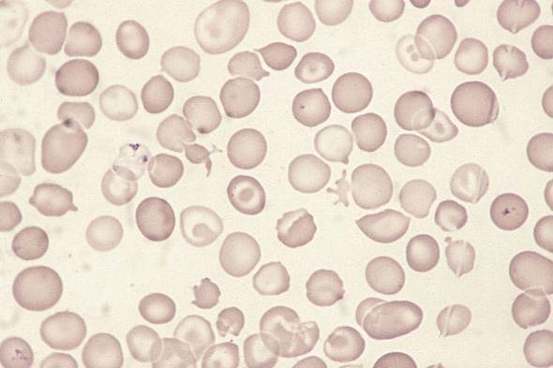
Blood film
© Wiley-Blackwell, from Bain BJ, Interactive Haematology Imagebank, 2nd Edn, 2012.

Slide 4
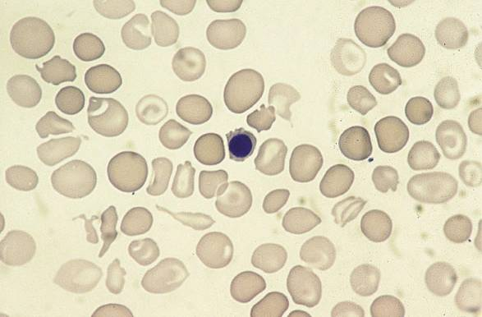
Blood film
© Wiley-Blackwell, from Bain BJ, Interactive Haematology Imagebank, 2nd Edn, 2012.

Slide 5
Q1) Based on the blood count and film, what is the most likely explanation of the microcytic anemia?
Acquired sideroblastic anemia
Alpha thalassaemia
Beta thalassaemia
Haemoglobin H disease
Iron deficiency on treatment

Slide 6
Q1) Based on the blood count and film, what is the most likely explanation of the microcytic anemia?
Acquired sideroblastic anemia
Alpha thalassaemia
Beta thalassaemia
Haemoglobin H disease
Iron deficiency on treatment

Slide 7
Blood film
The blood film showed
  Dimorphism with hypochromic microcytes and normochromic normocytic erythrocytes
  Pappenheimer bodies
  Occasional Howell-Jolly bodies
  Occasional acanthocytes and other poikilocytes
  Occasional micronormoblasts

Slide 8
Bone marrow aspirate
A bone marrow aspirate was markedly hypercellular
There was a striking increase in erythropoiesis and a mild increase in megakaryocytes
Granulopoiesis was reduced
Megakaryocytes included hypolobated forms and micromegakaryocytes
Erythroblasts showed increased siderotic granulation with a few ring sideroblasts
Cytogenetic analysis was normal

Slide 9
Q2) According to the 2008 WHO classification, the diagnosis is
Refractory anaemia
Refractory anaemia with multilineage dysplasia
Myelodysplastic/myeloproliferative neoplasm, unclassified
Essential thrombocythaemia
Myelodysplastic syndrome, unclassified

Slide 10
Q2) According to the 2008 WHO classification, the diagnosis is
Refractory anaemia
Refractory anaemia with multilineage dysplasia
Myelodysplastic/myeloproliferative neoplasm, unclassified
Essential thrombocythaemia
Myelodysplastic syndrome, unclassified

Slide 11
Q3) Haemoglobin electrophoresis showed a fast moving variant haemoglobin. What test would you do next?
DNA analysis
Haemoglobin H preparation
Quantification of haemoglobin A2
Reticulocyte count
Serum ferritin assay

Slide 12
Q3) Haemoglobin electrophoresis showed a fast moving variant haemoglobin. What test would you do next?
DNA analysis
Haemoglobin H preparation
Quantification of haemoglobin A2
Reticulocyte count
Serum ferritin assay

Slide 13
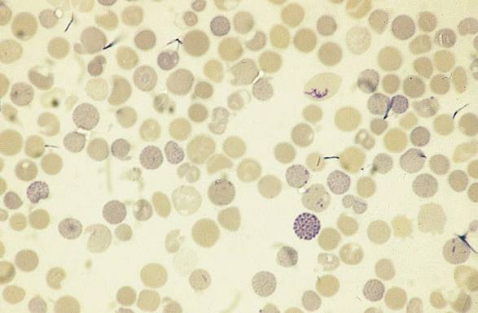
Haemoglobin H preparation
© Wiley-Blackwell, from Bain BJ, Interactive Haematology Imagebank, 2nd Edn, 2012.

Slide 14
Further investigations
Haemoglobin H 15%
Globin chain synthesis: α:β ratio 0.49 (normal ~ 1.1)

Slide 15
Q4) You expect DNA analysis to show
Deletion of one α gene
Deletion of two α genes
Deletion of three α genes
Deletion of four α genes
All α genes intact

Slide 16
Q4) You expect DNA analysis to show
Deletion of one α gene
Deletion of two α genes
Deletion of three α genes
Deletion of four α genes
All α genes intact

Slide 17
Further investigations
DNA analysis showed no α gene deletion

Slide 18
Q5) The usual mechanism of acquired hemoglobin H disease is
Deletion of two or three α genes
Hypermethylation of α gene promoters
Reversion to fetal type erythropoiesis
Acquired somatic mutation of the ATRX gene
Up-regulation of β gene expression

Slide 19
Q5) The usual mechanism of acquired hemoglobin H disease is
Deletion of two or three α genes
Hypermethylation of α gene promoters
Reversion to fetal type erythropoiesis
Acquired somatic mutation of the ATRX gene
Up-regulation of β gene expression

Slide 20
Q6) The most likely genetic abnormality in MDS/MPN unclassified with microcytic anemia and thrombocytosis is
JAK2 V617F
KIT D816V
MPL mutation
BCR-ABL1
Mutation in mitochondrial genes

Slide 21
Q6) The most likely genetic abnormality in MDS/MPN unclassified with microcytic anemia and thrombocytosis is
JAK2 V617F
KIT D816V
MPL mutation
BCR-ABL1
Mutation in mitochondrial genes

Slide 22
Follow-up
The patient became pancytopenic
Over the next 6 months he became neutropenic and suffered recurrent infections
The percentage of erythroid cells in the bone marrow fell and the blast cell percentage rose

Slide 23
Feedback
Q1 The most probable explanation of the haematological abnormalities would be acquired sideroblastic anaemia (although this turned out not to be the case)
Q2 There is anaemia with bilineage dysplasia plus thrombocytosis so the diagnosis is myelodysplastic/myeloproliferative neoplasm, unclassified
Q3 In the case described the fast moving band is likely to be haemoglbin H so a haemoglobin H preparation would be a good initial step

Slide 24
Q4 In the majority of patients with acquired haemoglobin H disease, all α genes are intact
Q5 The condition is due to an acquired somatic mutation of the ATRX gene leading to down-regulation of α gene expression
Q6 Most cases of are MDS/MPN with microcytic anaemia and thrombocytosis have sideroblastic erythropoiesis, this combination of disease features being often associated with JAK2 V617F

Slide 25
Discussion
The ATRX gene encodes a transactivating factor that is important for α gene expression
Germline mutation leads to haemoglobin H disease
Somatic mutation can lead to acquired haemoglobin H disease, particularly in males (90% of cases)
Acquired haemoglobin H disease has been associated with MDS, AML, primary myelofibrosis and MDS/MPN
Unlike inherited haemoglobin H disease, a dimorphic blood film is common

Slide 26
Discussion
Haemoglobin H can be as high as 60-65%
Haemoglobin H has a markedly left-shifted oxygen dissociation curve so that syptoms of anaemia are much worse than would be expected from the Hb

Slide 27
References
Mercieca J, Bain B, Barbour G and Catovsky D (1996) Teaching cases from the Royal Marsden and St Mary’s Hospitals, Case 10: microcytic anaemia and thrombocytosis. Leuk Lymphoma, 21,185-186.
Gibbons RJ, Pellagatti A, Garrick P, Wood WG, Malik N, Ayyub H et al. (1995) Identification of acquired somatic mutations in the gene encoding chromatin-remodeling factor ATRX in the alpha-thalassaemia myelodysplasia syndrome (ATMDS). Nat Genet, 34, 446-449.

Slide 28
References
Steensma DP, Higgs DR, Fisher CA and Gibbons RJ (2004) Acquired somatic ATRX mutations in myelodysplastic syndrome associated with α thalassemia (ATMDS) convey a more severe hematologic phenotype than germline ATRX mutations. Blood, 103, 2019-2026.
Bain BJ. Haemoglobinopathy Diagnosis, 2nd Edn, Blackwell, 2006, pp 234-236.

